Slide 1

The College Application Process

Slide 2

People to Know!
Counselors Works With
  Loretta Collins Last Names A-D
  Herb Crowell Last Names E-J
  Amy Webster Last Names K-M
  Amy Webster Last Names N-Sa
  Teresa Savage Last Names Sb-Z
CCC Coordinators
  Danielle Seifert All Students
  Eman Abdullahi All Students

Slide 3
Music Courtesy of.........
The Billboard Top 100 1982……..
The year Crowell graduated from Hunterdon Central High School, New Jersey!

Slide 4
Graduation Requirements
Course | Credits | Notes
Total credits offered | 28 credits | Credit status letter sent home October 1st. Web-based credit recovery has started. Student can sign up in the counseling office. Students taking MPS Online Fitness and Health should know their credit requirements.
Total needed to graduate | 21.5 credits
English | 4 credits (4 years)
Social Studies | 4 credits (4 years)
Math | 3 credits (3 years)
Science | 3 credits (3 years)
Health | 1 credit (1 year)
PE | 1 credit (1 year)
Fine Arts | 1 credit (1 year)
Electives | 4.5 credits

Slide 5
From a Director…
Every year thousands of students go through the college search. Every year thousands of students end up in college. ..
…You will too.

Slide 6

Counselor Advice for Students
Yes, soon, you will be making a leap into your future. You can do it.
Make informed choices
Engage with the process
Use your resources well
Remain calm and organized
The “best” school is the one that fits you best. By the way, there is no one single “best" school for you.

Slide 7
Roles
Student
    Project Manager (aka “The Application Doer”, “The Appointment Maker”, “The Requester of Letters”)
Parent
    Provide supporting conversations
    Providing reality checks (financial resources, fit)
Counselor/Career Center Coordinator
    Answer questions
    Provide resources
    Send transcripts and forms/writing letters/assisting teachers
    Provide reality checks

Slide 8

Weekly Rotating Counselor Advisory Presentations
Senior Meeting (9/15)
U of M, TC; UW Madison (9/22 )
Private College Applications (10/6)
Writing the Essay (10/13)
MNSCU and UW campuses (10/27)
Community/Tech Ed Schools & Apprenticeships (11/10)
Financial Feasibility (11/17)
Financial Aid Overview (12/1)
Scholarships (12/8, 2/2)
Decoding Financial Aid packages (3/23)
Senior Exit Surveys (May)

Slide 9
Apply! Order of Operations
  Create Your List
  Complete Applications
  Make Appointment with Counselor
  Request letters from teachers, if needed
  Request test scores sent from ACT/SAT, if necessary
  Track Application, Transcripts, and Letters through Naviance and college’s portal
  Pay $2 per transcript fee to Counseling Office in May
  NOTE: Students can send applications in piecemeal

Slide 10
Create Your List

Slide 11
Creating Your List
A good school is one that is a good fit for you
A school where you will be happy, engaged, grow and that meet your needs
  Educational
  Personal
  Social
  Financial

Slide 12
Create Your List
Factors in your “Objectively Important Profile” (published)
  G.P.A.
  Class Rank
  ACT or SAT Test Scores
Factors in your “Subjectively Important Profile” (unpublished)
  Rigor of Courses
  Activities/ Unusual Talent
  Diversity (Race, Ethnicity, Income, Geography)

Slide 13
Create Your List
Likely – realistic
  Your profile is SIGNIFICANTLY stronger than the typical freshman
  60-90% chance of admission
Possible – selective
  Your profile is similar to the typical freshman
  30-60% chance of admission
Reach – more selective
  Your profile is not as strong as the typical freshman
  less than 30% chance of admission

Slide 14
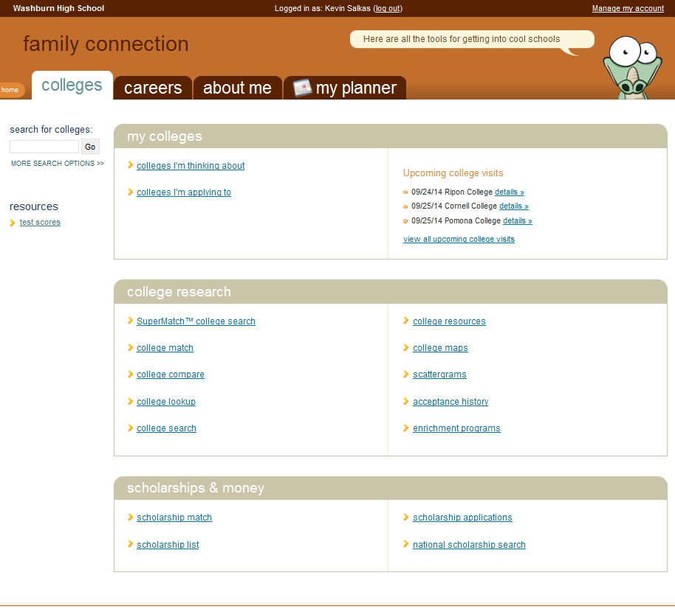

Slide 15
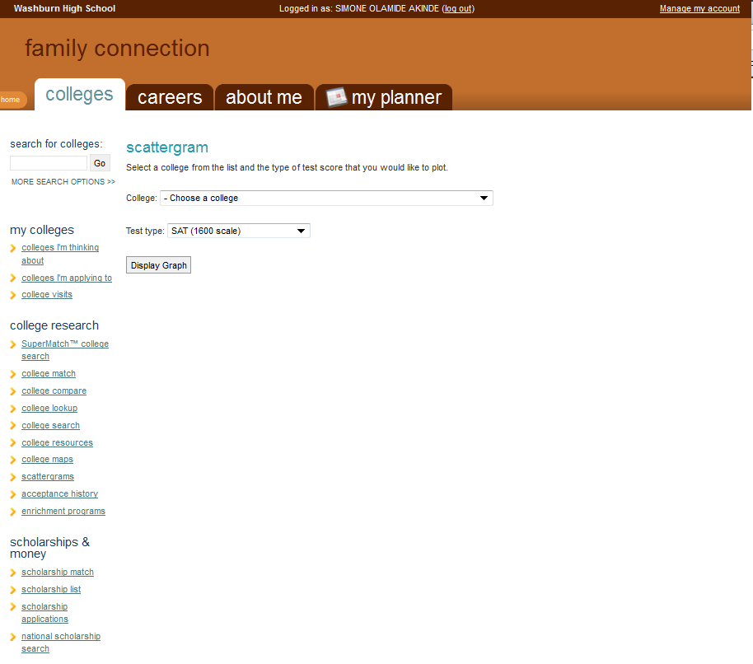
Select the school you’re interested in!
Select your best test!

Slide 16
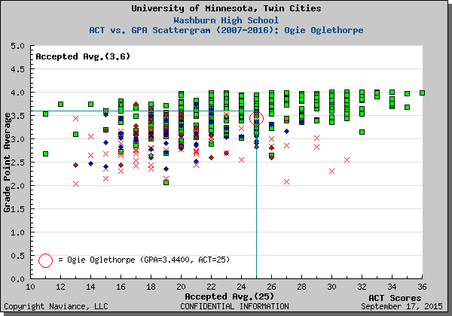
Use of Scattergrams

Slide 17
Web-based College Search Resources
Naviance- Super College Match
    Good for sorting schools given individualized criteria
    Information comparing oneself to former WHS applicants
Collegeboard.org
    Broader information comparing oneself to all applicants
    Cross references schools (i.e. “those applying to school A also apply to schools B, C, and D”
Collegeresults.org
    Groups “similar” schools together for comparison by varying metrics like demographics, admission rates, financial aid awards

Slide 18

CCC Visits To Washburn
  College/Scholarship/Community Reps
  NEW!→ Career Talks
  Project Success college tours
  Why Sign Up For a CCC Visit?
    Ask questions
    Explore without leaving Minneapolis
    Help add or remove schools from your list
    Learn about community/summer opportunities

Slide 19
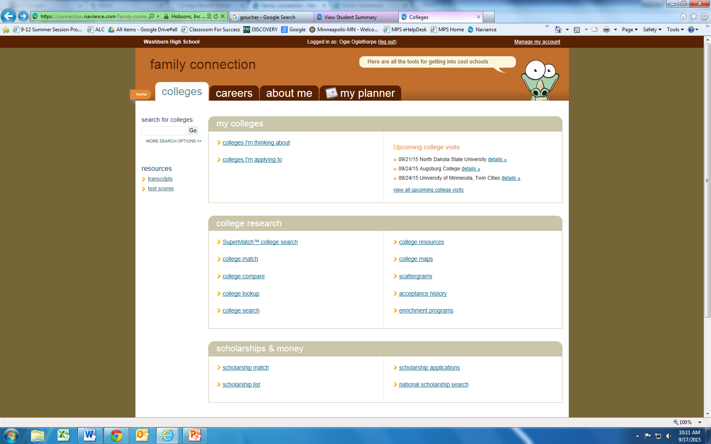

Slide 20
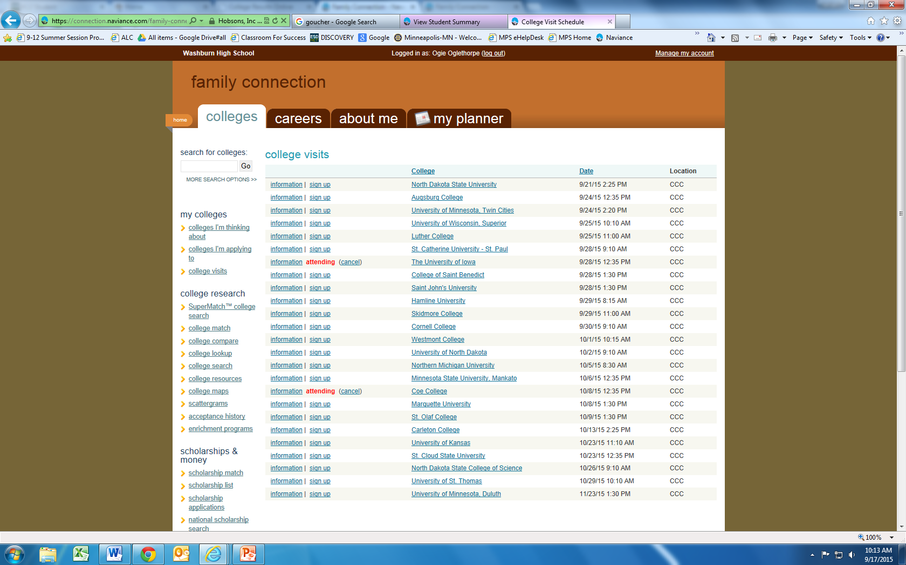

Slide 21
CCC Visits
Students will receive a pass in their 1st period class the day of the visit. If they do not have a 1st period, they must obtain a pass from the CCC before the visit.

Slide 22
Complete Your Applications

Slide 23
Complete Your Applications: Tips
Be Professional!
  Appropriate grammar, punctuation
  Formal language; do not use texting/tweeting format
  Professional e-mail address
Student should apply; not the parent
Follow all directions

Slide 24
Deadline Terminology
  Rolling Admissions
  Regular Deadline
  Early Action/Priority Deadline
  Early Decision

Slide 25
Complete Your Applications
  Know which application methods will be the least time consuming.
    The Common Application
    Institutional Application
    The Coalition Application (new)

Slide 26

Common Application
Single application that can be sent to participating schools.
500+ member institutions
Must create an account and communicate with counselor.
Some member institutions require the Common App; Optional for others; Institutional App is sometimes easier

Slide 27
Meet With Your Counselor

Slide 28
Meeting with the Counselor
  A. GET READY (20 min): Question and Answer.
  B. GET SET (30 min): Set list of schools on Naviance.
        Transcripts sent
        Match Naviance with Common App
        Sign FERPA waiver
        Request Fee Waiver for App Fees
        Declare Teacher Recommendations
  C. GO: If needed, counselor interview to write a letter of recommendation meeting with us first (45 minutes).
  Student can also meet with Ms. Seifert or Ms. Eman in CCC at any time for questions and answers. Appointments for a counselor meeting can be made with Maggie in the counseling office.

Slide 29
Request Letters Of Recommendation
If needed…

Slide 30

Letters of Recommendation
Check applications carefully to see if you need one
  Also check how many. Send the appropriate number.
Fill out Rec Forms if desired.
Request 3-4 weeks prior to when needed
Thank you note to teacher

Slide 31
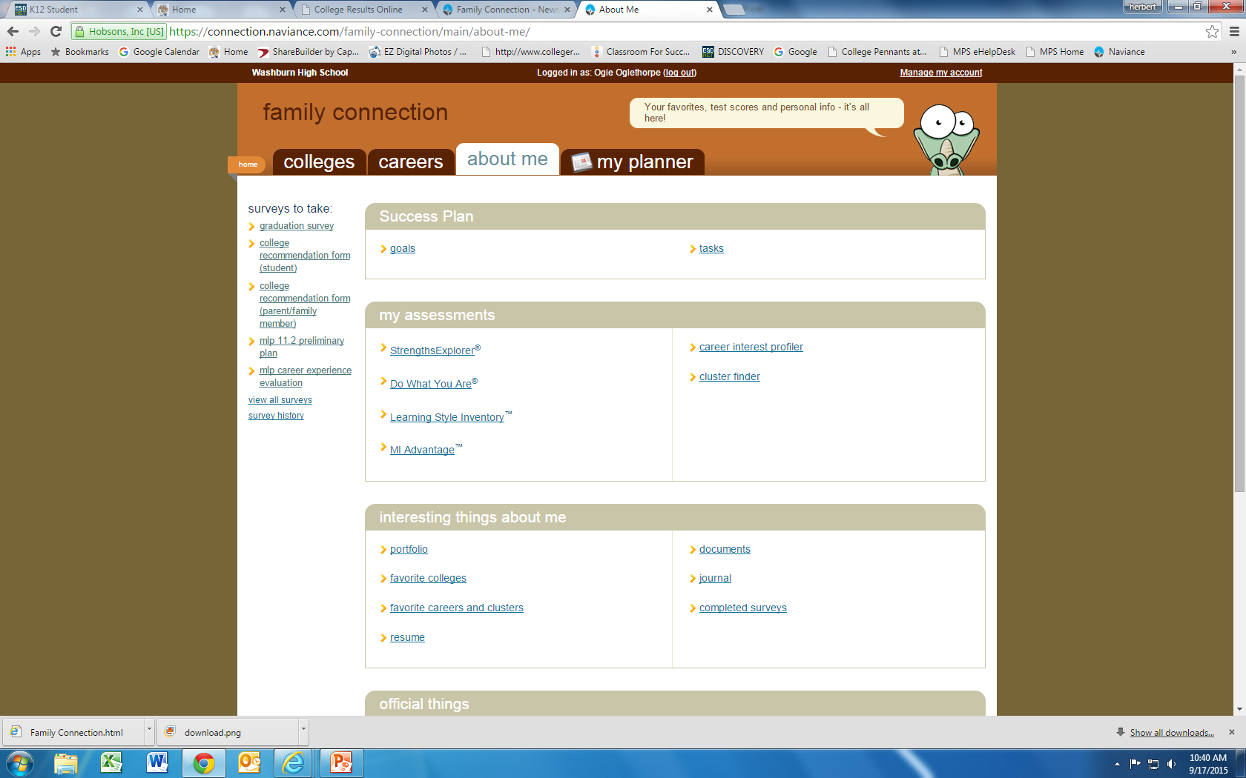

Slide 32
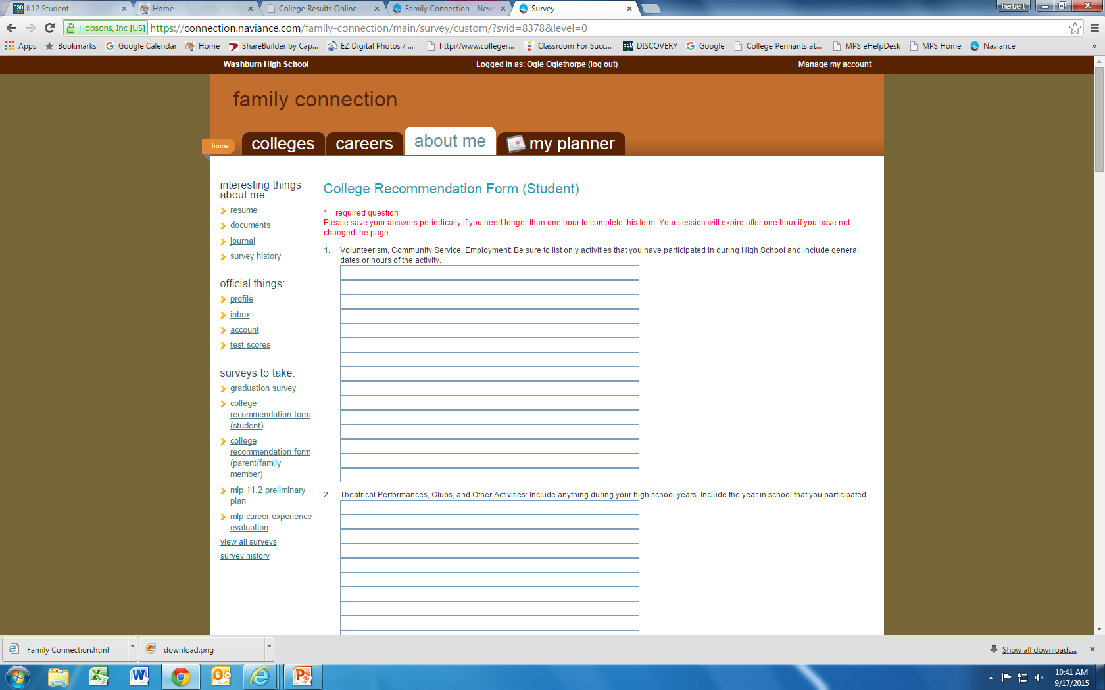

Slide 33
Send Your ACT Scores
If you haven’t already…

Slide 34
Send Your ACT Scores
If you added schools to a previous ACT
  Make sure they are the schools your are actually applying to!
If you did not…or if you have added schools…
  Log into actstudent.org and request you ACT be sent.
  $12 per score, per school.

Slide 35
Track Your Applications

Slide 36
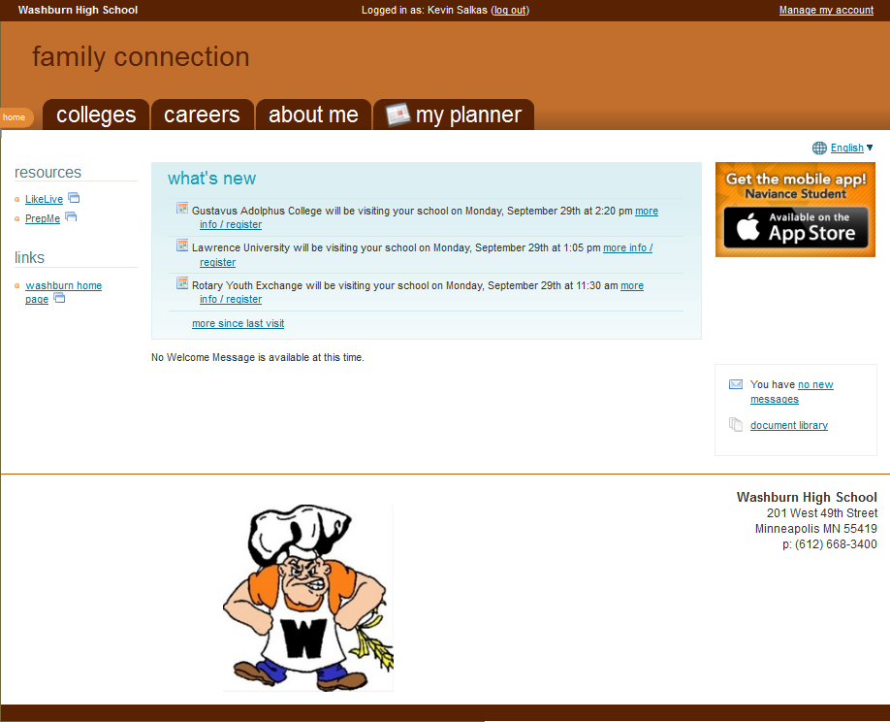

Slide 38
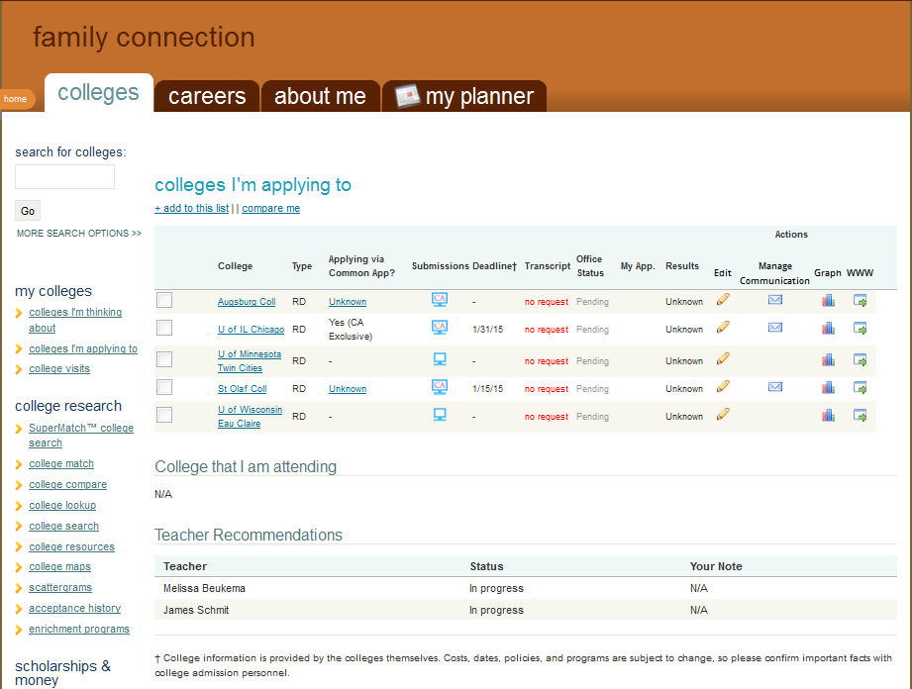

Slide 39
Time for a Deep Breath…
Seriously. Do it.

Slide 40
Fall Timeline
Theme: Applications
      9/22 College Application and FAFSA Night for families
      10/4 & 5 National College Fair @ Convention Center
      10/7 Senior Status letters sent home
      10/22 ACT (with late fee apply by 9/30)
      11/1 U of M application deadline
      11/8 MNACC College Fair @ Washburn
      12/3 SAT 2 Subject Test (10/19 deadline)

Slide 41
Winter Timeline
Theme: Scholarships and Financial Aid
      11/10 FAFSA Presentation Night
      11/17 MN Dream Act FAFSA Night
      12/10 ACT (register by 11/4)
      12/13 FAFSA/MN Dream Act Workshop
      2/1 Washburn Scholarship Applications distributed
      3/1 Application Decisions
      3/1 FAFSA “Deadline”
      3/23 FAFSA/MN Dream Act Workshop

Slide 42
Spring Timeline
Theme: Decision Making/Graduation
3/25 Spring Break: Final visits to colleges?
4/10 Grad status letter #2 mailed home
5/1 College Enrollment Decisions Due!
5/1 Washburn Scholarships announced (Date TBD)
6/7 Washburn Graduation (4:30pm)
6/15 Final transcripts mailed to colleges from
counseling office
7/1 Be sure to request AP/IB/College credits are forwarded to college

Slide 43
Finally…

Slide 44
Financial Aid
FAFSA can be submitted earlier than ever. Opens October 1st. (Prior-Prior Year)
Need-based aid for 2017-2018 school year now based on 2015 taxes.
You must submit your 2015 tax information-colleges will not process FAFSA’s with 2016 tax information
If 2015 is not reflective of current financial reality (medical expenses, divorce, etc.)- you must submit an appeal with the college financial aid office. To do so, contact your college’s financial aid office.
Reciprocity between public institutions MN, WI, ND, SD, Manitoba.

Slide 45
Financial Aid and Scholarships
November10th at Washburn: Merit Aid
Net Price Calculators
  Any institution that can receive student financial must supply a calculator on it’s website
  Several “vendors” of net price calculators so they may look different.
Don’t forget about FAFSA estimators
  www.finaid.org
  www.getreadyforcollege.org
  www.collegeboard.org

Slide 46
Helpful Resources
Financial Aid Counselors at colleges where student is applying
CCC Newsletter- sent electronically through Naviance (example paper copies)
Office of Higher Education financial aid staff (651) 642-0567 or (800) 657-3866
    www.ohe.state.mn.us
Handouts
  Power Point copies and on WHS counseling website
  Orange- Financial Aid Changes Handouts
  Blue- OHE Resources
  White- tax benefits
Questions on federal aid program and application process (800) 433-3243
    www.student.ed.gov

Slide 47


