Slide 1

ADVANCED ACADEMICS AND DUAL CREDIT

Slide 2
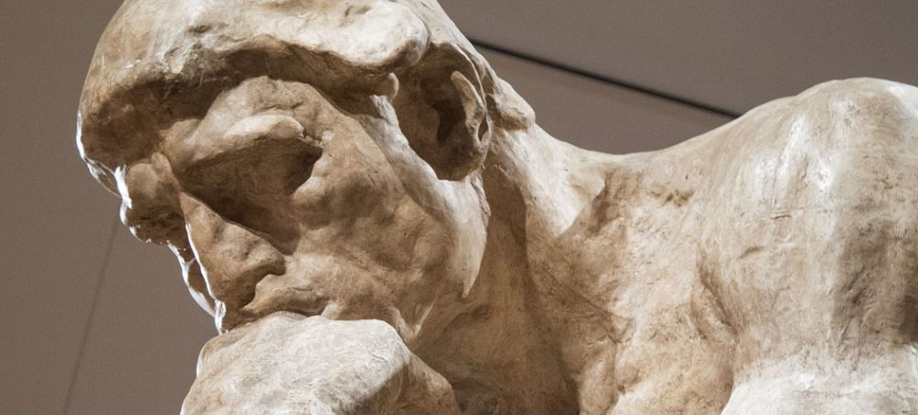
Advanced Academics and Dual Credit
Agenda
  Introductions
  Advanced Academics and Dual Credit Options
  Advanced Placement
  International Baccalaureate
  PSEO
  PLTW, CLEP, and MCTC in the classroom
  Questions

Slide 3
People to Know
Counselors
  Loretta Collins (A-D)
  Herb Crowell (E-J)
  Amy Webster (K-M)
  John Pemberton (N-Sa)
  Teresa Savage (Sc-Z)
IB Coordinator
  Jeanne Dobson

Slide 4


Why Advanced Academics?
Preparation for college
Recognition by college admissions office
Potential savings on tuition
    Depends on receiving institution
    Question to ask: “Does the credit count toward graduation or used for placement in higher level classes?”
Avoiding college remedial courses; 1/3 of MPS graduates take a remedial class in college

Slide 5

Advanced Placement Courses

Slide 6

Advanced Placement (AP)
AP courses are college level classes that students take at Washburn
More academically challenging than regular classes
Great preparation for future advanced courses at Washburn
Potential college credit
Classes offered at Washburn:
  AP English Literature and Comp (10th grade)
  AP Human Geography (9th grade)
  AP Statistics
Testing in May (score range: 1-5)

Slide 7

International Baccalaureate (IB)

Slide 8

International Baccalaureate (IB)
IB courses are college level classes that students take here at Washburn
Known for setting high standards and emphasizing creative and critical thinking.
Students are responsible for their own learning, choosing topics and devising their own projects, while teachers act more as supervisors or mentors than sources of facts.
Emphasizes research and encourages students to learn from their peers.

Slide 9
IB Certificate
One or more SL or HL Courses
Earn a passing grade in each course
May exams
Participation in the May 2016 or 2017 examination session
Complete all internal assessments for each course

Slide 10
IB WHS Medallion
2 HL and/or 2 SL Courses
Earn a passing grade in each course
May exams
Participation in the May examination sessions
Complete all internal assessments for each course
CAS (Creative, Action & Service)
Enter Goals online
Enter completed hours online with supervisors name, email, and phone number
Enter a reflection for each activity
TOK (Theory of Knowledge)
Earn a passing grade in the course
Complete the TOK Essay
Complete the TOK Presentation

Slide 11

IB Diploma
3 HL and 3 SL Courses (Max 4 HL)
Earn a passing grade in each course
TOK (Theory of Knowledge)
Earn a passing grade in the course
May exams
Participation in the May 2016 and 2017 examination sessions
Complete all internal assessments for each course
EE (Extended Essay)
Choose a Teacher Advisor in January of your Junior year
Read the Guide
Research!
Draft due: August
your senior year
Final due: January your Senior year
Complete the TOK Essay
Complete the TOK Presentation
Email the IB office to request scores to be sent to the college of your choice
CAS (Creative, Action & Service)
Enter Goals online
Enter completed hours online with supervisors name, email, and phone number
Enter a reflection for each activity

Slide 12
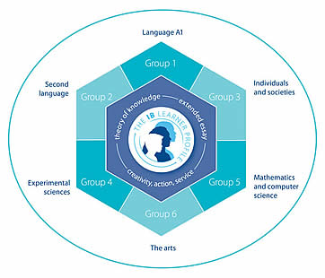
IB Courses at Washburn
Group 1 (Language and Literature)
    Language and
    Literature HL
    Literature HL
Group 2 (Language Acquisition)
    Spanish SL and HL
    French SL and HL
Group 3 (Individuals and Societies)
    History HL
    History SL
Group 4 (Experimental Sciences)
    Physics SL* or HL
    Chemistry SL
    Biology SL or HL
    IB DP SL Sports, Exercise and Health Science
    Environmental Systems &
    Societies (ESS) SL
Group 5 (Mathematics)
    Math Studies SL
    Math SL
    Math HL
Group 6 (The Arts)
    Visual Arts SL or HL
    Music SL*

Slide 13
IB Diploma/Medallion Timeline
  Sophmore Year
  Have to plan for completing P.E. and Health requirements
  Diploma Programme information sessions: Take place during registration
  Choose from the following Diploma Programme options: full IB diploma, WHS IB medallion, or participant
  Establish a habit of service- explore different community volunteering options. Experiences from the summer after sophomore year can be used for official Creativity, Action, and Service (CAS) experiences.

Slide 14
JUNIOR YEAR
SEMESTER 1
Double check with counselors and IB coordinator that your schedule is correct for the programme that you have selected.
Creativity, Action and Service (CAS)
Extended Essay (EE) – Students meet with the coordinator to begin choosing their topics; the coordinator will begin the process with the student to match up with an EE supervisor.
Ensure that you are scheduled to begin Theory of Knowledge class for second semester.
Register for May exams- juniors can take (but are not required to) up to two SL exams -- DO NOT MISS THE DEADLINE!!!

Slide 15
JUNIOR YEAR
  SEMESTER 2
  Begin Theory of Knowledge class.
  Various internal assessments (IAs) due- refer to assessment calendar.
  Work on CAS requirements and record reflections in ManageBac.
  May exams- External assessments in up to two IB subjects. Refer to exam calendar.
  Meet with your EE supervisor before the end of the school year to establish a timeline that works for the two of you.
    Example: EE outline emailed to supervisor by July 15th and complete a rough draft by the first day of school.

Slide 16
SENIOR YEAR
SEMESTER 1
Double check with counselors and IB coordinator that your schedule is correct for the programme that you have selected. Ensure that you are signed up for the second section of TOK.
Extended Essay
  Turn in rough draft on the day you and your supervisor have agreed to
  Meet with supervisor periodically over quarter 1 to work on final draft.
  Turn in final EE draft!
Various IAs due – refer to assessment calendar.
Work on CAS requirements and record reflections in ManageBac.
Register for May exams- DO NOT MISS THE DEADLINE!!!
Work on college application essays

Slide 17
SENIOR YEAR
  SEMESTER 2
  Study for May exams. Take advantage of after school tutoring and special sessions to prepare for the exams. Finish CAS requirements and record reflections in ManageBac.
  Various IAs due- refer to assessment calendar.
  May exams- External assessments in all IB subjects (except anticipated subjects taken junior year). Refer to exam calendar.
  June- Graduation!

Slide 18

PSEO

Slide 19

POST SECONDARY ENROLLMENT OPTIONS
The Minnesota Legislature created Post-Secondary Enrollment Options programs in 1985 to promote rigorous course taking and improve student transitions to postsecondary education. Postsecondary Enrollment Options allows high school juniors, seniors and some sophomores to take college courses at an actual college.

Slide 20
Why PSEO?
Students who participate in PSEO prefer the learning environment of being on a college campus. They may be receiving credit for high school requirements/classes and also credit for their college level courses.
  Example: Taking a 4 credit English course at the University of Minnesota will earn the student those 4 credits AND 4 credits of English for Washburn

Slide 21

Considerations for PSEO
Maintain close contact with WHS counselor for course approval, other important information.
Limited to full-time status.
All grades added to WHS transcript.
Any C- or less likely will result in probation.
Transfer of credits subject to discretion of receiving institution.
Part-time students must be wary of and responsible for change of classes to start 2nd semester.
Success rate
10th gradeers are eligble for CTE classes at MCTC (Accounting, Graphic Design, etc.)
11th and 12th graders are eligible for all classes the student qualifies for

Slide 22
Local PSEO Programs
University of Minnesota (25)
  Minneapolis Community and Technical College (21)
  Normandale (4)
  North Central University (1)
  Concordia
  St. Kates’
  Hamline
  Macalester
  Belthel
  McNally Smith
  St. Paul College
  Northwestern
  MCAD
  Dunwoody

Slide 23

University of Minnesota
Application deadline April 1st (One enrollment period for year)
GPA, course rigor, essay, PLAN test scores
Typical Enrollee: 3.75 GPA or slightly lower but with high test scores
Basic form must be completed on-line but additional paperwork must be picked up in counseling office and turned in to the U of M:
  Instructions
  Balance Sheet
  PSEO notice
  2 Essays completed on paper
  Plan scores?
Requires counselor sign-off
Placement testing for Math and World Language after admission
Science classes usually have a high school pre-requisite

Slide 24

Minneapolis Community and
Technical College (MCTC)
June 1st / December 1st deadlines
Juniors: Top 1/3 of class or 3.0 GPA
Seniors: Top ½ of class or 2.5 GPA
Pass the Accuplacer Test
Application is on-line only: pick-up instructions and other materials in counseling office.
Courses in Nursing, Air Traffic Control, Audio Production, Cinema, Video Arts, Photography are not available to PSEO students.

Slide 25

Normandale Community College
Application deadline: July 1st and Dec. 1st
Juniors: Top 1/3 of class or 70th percentile on PLAN
Seniors: Top ½ of class or 50th percentile on PLAN
Pick-up application in counseling office and mail in with transcript and counselor signed form.

Slide 26
PSEO Application Steps
1. Pick up application materials in WHS Counseling Office or download/apply directly through college website.
2.Be sure to submit all required materials (transcript, Notice of Registration, and when required, essays/exams/balance sheets)
3.After notification of acceptance, attend orientation
4. Meet with WHS counselor to approve credits and set-up schedule (August)

Slide 27



Other Options
Project Lead the Way (PLTW)
  Engineering
CLEP Exams
MCTC Intro Stats

Slide 28
Articulation Examples
University of Minnesota
  Accepts IB Higher Level scores of 5 or above for credits (8 cr)
  Accepts AP scores of 3 or above for credit (3-4 cr)
  Accepts some CLEP scores of 60 or above for credit ( 3-4 cr)
  Accepts PSEO credits
MNSCU schools (i.e. St. Cloud, Mankato, Winona)
  Accept IB Higher Level scores of 4 or above for 3 credits. Accept IB Standard Level scores of 4 or above for 2 credits.
  Accept AP scores of 3 or above for credit (3 cr)
  Accept all CLEP scores of 50 or above for credit (3 cr)
  Accept PSEO credits

Slide 29

Questions?

