Slide 1
Dual Enrollment:
Post Secondary Enrollment Options

Slide 2
Earning College Credit & High School Credit at The Same Time (Dual Credit)
Preparation for college
Recognition by admissions offices
COA savings vs reduced course load
“Does the credit count toward graduation or just used for placement in higher level classes?”

Slide 3
Dual Credit Opportunities
AP Exams
IB Assessments
PLTW Courses
College Courses at Washburn
CLEP Exams
Post-Secondary Enrollment Options (PSEO)

Slide 4
Articulation Examples
University of Minnesota
Accepts IB Higher Level scores of 5 or above for credits (8 cr)
Accepts AP scores of 3 or above for credit (3-4 cr)
Accepts some CLEP scores of 60 or above for credit ( 3-4 cr)
Accepts PSEO credits
MNSCU schools (i.e. St. Cloud, Mankato, Winona)
Accept IB Higher Level scores of 4 or above for 3 credits. Accept IB Standard Level scores of 4 or above for 2 credits.
Accept AP scores of 3 or above for credit (3 cr)
Accept all CLEP scores of 50 or above for credit (3 cr)
Accept PSEO credits

Slide 5
POST SECONDARY ENROLLMENT OPTIONS
The Minnesota Legislature created Post-Secondary Enrollment Options programs in 1985 to promote rigorous course taking and improve student transitions to postsecondary education. Postsecondary Enrollment Options allows high school juniors, seniors and some sophomores to take college courses at an actual college.

Slide 6
Local PSEO Programs
University of Minnesota (27)
Minneapolis Community and Technical College (24)
Normandale (4)
North Central University (1)
Concordia (1)
St. Kate's’
Hamline
Macalester
Bethel
McNally Smith
St. Paul College
Northwestern
MCAD
Dunwoody

Slide 7
University of Minnesota
Application deadline April 1st (One enrollment period for year); May 30th notification; 500 admitted students out of 1200 applicants
GPA, course rigor, PSAT (considered, not expected)
Typical Enrollee: Average GPA 3.89 with rigorous courses
Step 1: Complete simple on-line application form
Step 2: Pick up paperwork from counseling office
Balance Sheet
PSEO notice of registration
PSAT/ACT scores
Step 3: Mail all materials to U of M
Placement testing for Math and World Language after admission
Science classes usually have a high school pre-requisite
Info sessions: 2/22, 2/24, 3/8 5:30 Bell Auditorium

Slide 8
Minneapolis Community and Technical College (MCTC)
June 1st / December 1st deadlines
Juniors: 3.0 GPA
Seniors: 2.5 GPA
Pass the Accuplacer Test
Fill out application on-line
Take the Accuplacer test and bring results to counseling office
Pick up balance sheet, transcript, notice.
Mail all materials to MCTC
Courses in Nursing, Air Traffic Control, Audio Production, Cinema, Video Arts, Photography are not available to PSEO students.
Sophomores allowed to take CTE courses only

Slide 9
Normandale Community College
Application deadline: July 1st and Dec. 1st
Juniors: Top 1/3 of class or 70th percentile on PSAT
Seniors: Top 1/2 of class or 50th percentile on PSAT
Pick-up application in counseling office and mail in with transcript and counselor signed form.
Informational Sessions: 2/2, 3/1 5:00pm

Slide 10
PSEO: High School versus College
HIGH SCHOOL
Teachers often remind you of due dates and assignments.
Teachers check your completed work
Testing is frequent and covers small amounts of material.
Teachers often arrange tests so as not to conflict with school events.
“Good faith” is often rewarded with a higher grade.
Classes meet every day.
Access to student information.
COLLEGE
Professors expect you to read, save , and consult syllabus for due date
Homework is not often given and rarely checked or used for grading. Expecting you can do a similar task on an exam.
Testing is infrequent, cumulative, and encompasses a large part of your grade.
Tests are scheduled without regard for other classes or activities.
Reading load is much heavier than high school.
“Good faith” effort is appreciate but typically doesn’t change the grade you earned.
Classes meet two or three times a week.
No parent access to student information.

Slide 11
Final Considerations for PSEO
Maintain close contact with WHS counselor for course approval, other important information.
Limited to full-time status.
All grades added to WHS transcript.
Any C- or less likely will result in probation.
Transfer of credits subject to discretion of receiving institution.
Part-time students must be wary of and responsible for change of classes to start 2nd semester.
Success rate

Slide 12
PSEO Application Steps
1. Pick up application materials in WHS Counseling Office or download/apply directly through college website.
2. Be sure to submit all required materials (transcript, Notice of Registration, and when required, exams/balance sheets)
3. Notify your counselor ASAP of acceptance
4. Attend orientation and registration session
5. Meet with WHS counselor to approve credits and review schedule (early to mid-August).

Slide 13
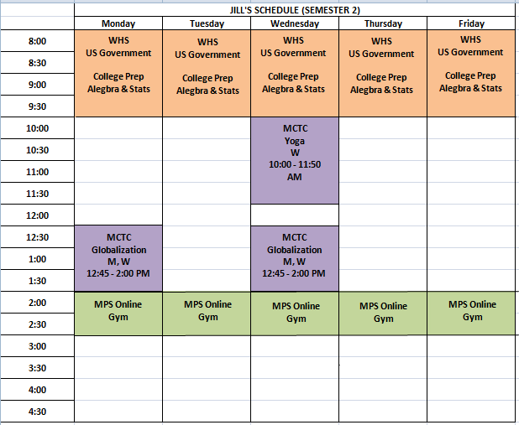

Slide 14
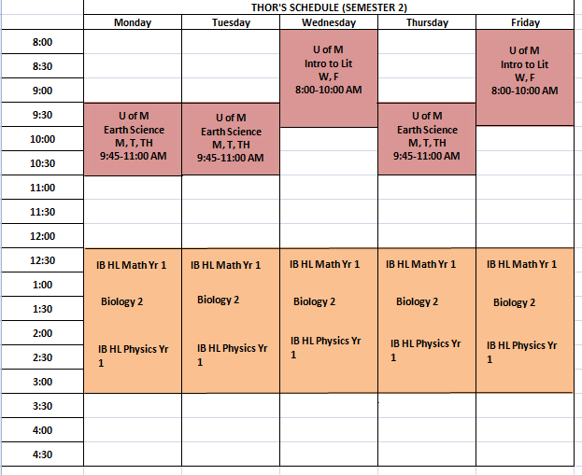

Slide 15
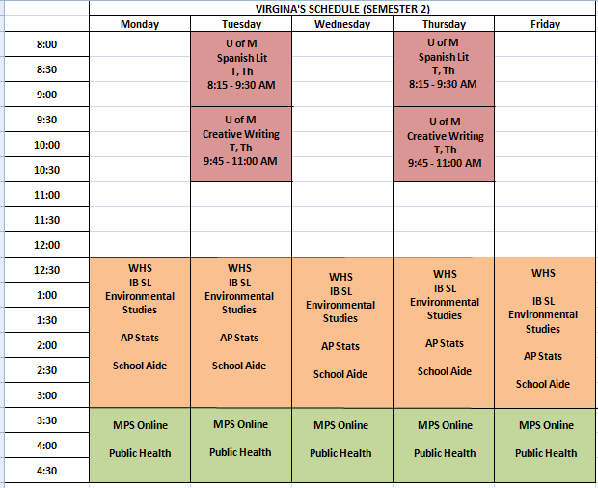

Slide 16
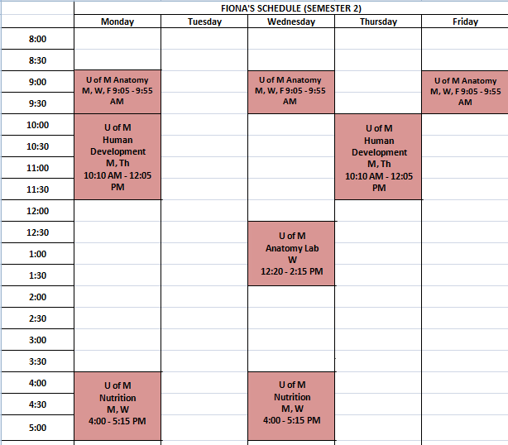

Slide 17
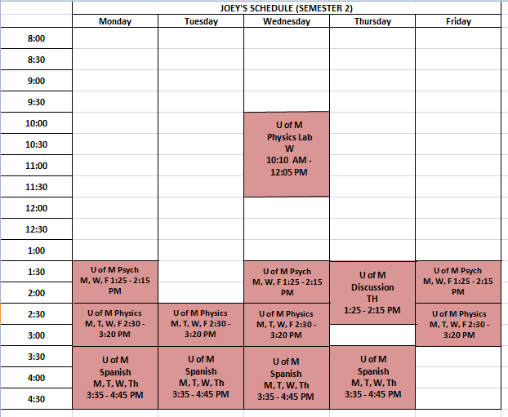

Slide 18
