Slide 1

FAFSA/MN Dream Act and Financial Aid 101

Slide 2

College Financial Aid Steps
APPLY TO COLLEGE
PARENTS WILL USE TAX FORMS FROM 2015
STUDENTS WILL USE TAX FORMS FROM 2015 (IF YOU WORKED)
FILL OUT FAFSA ON-LINE
RECEIVE YOUR STUDENT AID REPORT (SAR)/EFC
GOVERNMENT SENDS INFO TO YOUR COLLEGES
COLLEGES OFFER YOU THEIR FINANCIAL AID PACKAGE IN WINTER/SPRING
MAKE FINAL DECISION BY MAY 1

Slide 3

FAFSA
Document to fill out to receive federal and state student aid
Most important step you can take to receive financial aid
Must have a Social Security Number or a 1-94 number to apply (if you don’t have one there is information later in this presentation)

Slide 4
Before completing the FAFSA
Get this information
  Students: SSN*, 1-94*, date of birth, total amount of money saved, driver’s license number*
  Parents: SSN*, 1-94*, date of birth, total amount of money saved, date married/separated/divorced
Gather these documents
  Students: 2015 federal income tax returns*, W-2 forms*
  Parents: 2015 federal income tax returns*, W-2 forms*
  * = if applicable

Slide 5
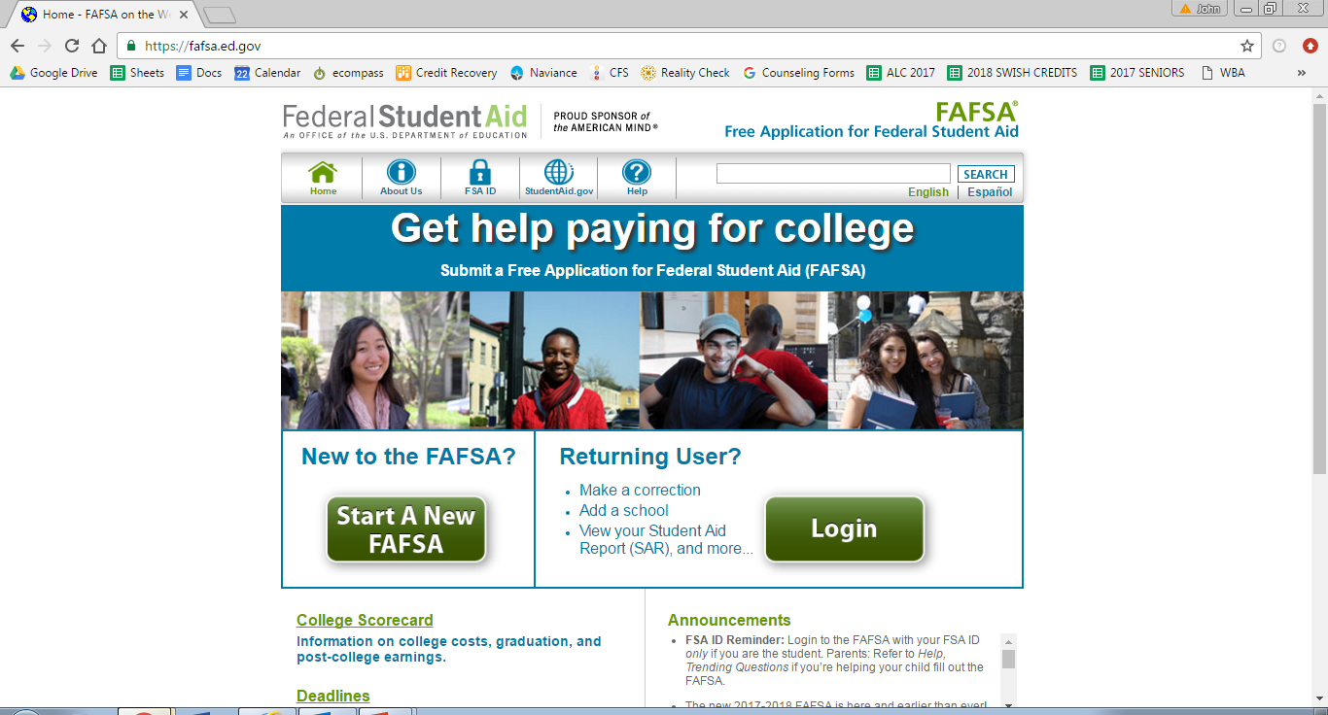
Complete the Free FAFSA at fafsa.gov
*Remember to record your FSA ID – very hard to get if you get forget!
There’s a worksheet in the CCC to help you!

Slide 6
You can apply for the FAFSA now
Do it!
This is the first year students have been able to apply before the end of the year (called the Prior Prior Year – PPY)
You will now be using tax information from the previous year (2015 tax information for the 2017 year)
Recommended to submit tax information with the IRS Data Retrieval Tool (DRT)

Slide 7

Other Financial Aid Tips
Fill out as early as possible!
Be SURE you report your social security name
and number as it appears on your card.
Do not be alarmed if you are selected for “verification”
For the FAFSA, your parents are ONLY your biological parents.
You are considered a “dependent” until you are 25.
  There are special circumstances in which a college may consider you independent.
Some colleges may ask you to fill out the CSS Profile
Reciprocity forms available on-line in Spring (getreadyforcollege.org)

Slide 8

What does "Financial Aid" mean?
Scholarships
Grants
Work Study
Loans

Slide 9
GRANTS
  Based on financial need
  Money you don’t pay back
  From the government
Federal Pell Grant: $5,815 max per year for 2016-2017
Federal SEOG Grant: limited funding; priority given to students
with exceptional need; amount will vary by school
Minnesota State Grant: MN residents only going to MN schools
Institutional Grant: varies by institution; talk to your college
financial aid office

Slide 10

WORK STUDY
  Given by schools and the state
  Have a job on campus
  Owe money if you don’t work enough.
  Start applying as soon as you know you’ve received it!

Slide 11

LOANS
Federal Loans = lower interest = BEST
  Subsidized vs.
  Unsubsidized
  Note if parents are
  offered loans too and
  consider total aid provided.
Subsidized: interest is subsidized (paid for) by the
government while you’re in school.
Unsubsidized: interest accrues while you’re in school.
Parent PLUS: a loan in your parent’s name for your
educational expenses

Slide 12

SCHOLARSHIPS
Awarded based on merit (GPA, activities, essay, etc.)
  Institutional Scholarships
  Independent Scholarships
BEWARE OF SCHOLARSHIP SCAMS!
THE CCC has resources if you want to apply for scholarships.

Slide 13

GET FAFSA and Dream Act HELP!
FAFSA/MN Dream Act Workshop Night
  Tuesday December 13th, 5-7pm
  Bring all financial forms with you!
  Chance to win a $500.00 scholarship if you attend this event.
College and Career Center Help
  Make sure you make an appointment

Slide 14
MN Dream Act
State aid for students who are undocumented (not a US citizen or eligible non-citizen)
Apply ONLY after you’ve gathered all financial forms because you have to send them to the MN Office of Higher Ed when you are done with the application.
Talk to your counselor and/or CCC if you are eligible (or unsure if you’re eligible)

Slide 15
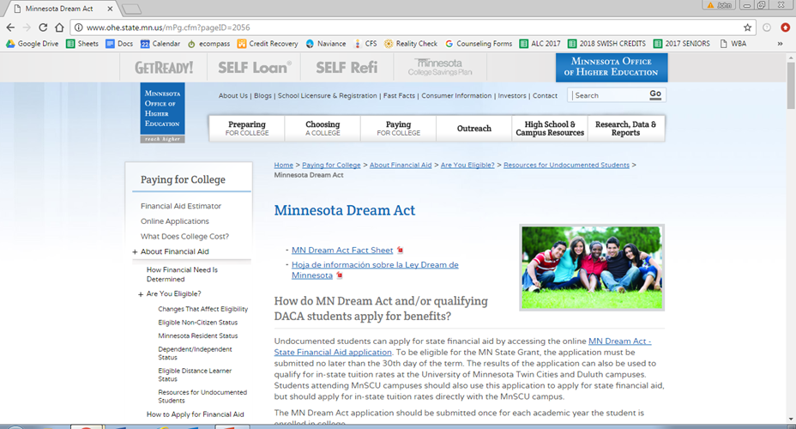
Complete the MN Dream Act at the Office of Higher Education website

Slide 16
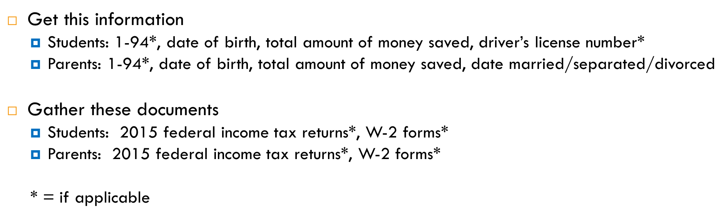
Filing for the MN Dream Act

Slide 17
Scholarships
Washburn’s Notable Private Scholarships List
  Good stuff
  WHS students have won in the past
  Scholarships worth your time!
CCC Newsletter- weekly updates on scholarships.
  This should be emailed to you. If you’re not getting it, fix your email info in the CCC!
Naviance holds scholarship master list- careful- not always updated. Check the CCC for the most updated info.
  Students who are undocumented: use the Scholarships for Dreamers list in the CCC and check out private scholarships available at: www.ohe.state.mn.us/MNDreamAct

Slide 18

Independent Scholarships
Wallin Scholarship (www.wallinpartners.org/apply)
Due: February 15, 2017
Minimum 3.0 GPA
Minimum 19 ACT
Attending a 4 year school in MN, WI, ND, SD, IA, or any HBCU
Family taxable income of $75,000 or less
Wallin sign-up sheet
*We will give a separate presentation when more become available

Slide 19

Questions, Comments, Concerns?

