Slide 1
Presentation & Student Panel 2/16/17
Post Secondary Enrollment Options (PSEO)

Slide 2
People to Know
Counselors
Loretta Collins (A-D)
Herb Crowell (E-J)
Amy Webster (K-M)
John Pemberton (N-Sa)
Teresa Savage (Sc-Z)
College and Career Center Coordinators
Danielle Seifert (M-F)
Eman Abdullahi (T-Th)

Slide 3
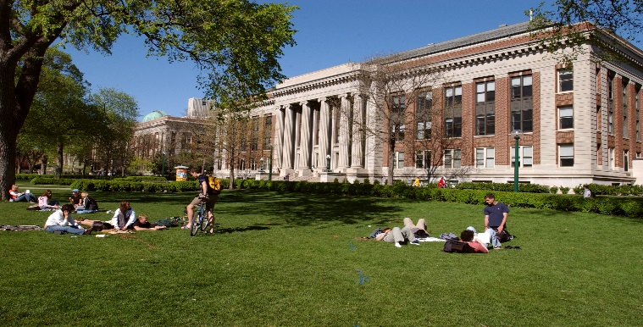
POST SECONDARY ENROLLMENT OPTIONS
The Minnesota Legislature created Post-Secondary Enrollment Options programs in 1985 to promote rigorous course taking and improve student transitions to postsecondary education. Postsecondary Enrollment Options allows high school juniors, seniors and some sophomores to take college courses at an actual college.

Slide 4
Local PSEO Programs
University of Minnesota
Minneapolis Community and Technical College
Normandale
North Central University
Concordia
St. Kate's’
Hamline
Macalester
Bethel
McNally Smith
St. Paul College
Northwestern
MCAD
Dunwoody

Slide 5
Why Advanced Academics?
Preparation for college
Recognition by college admissions offices
Potential savings on tuition
Depends on receiving institution
Question to ask: “Does the credit count toward graduation or used for placement in higher level classes?”

Slide 6
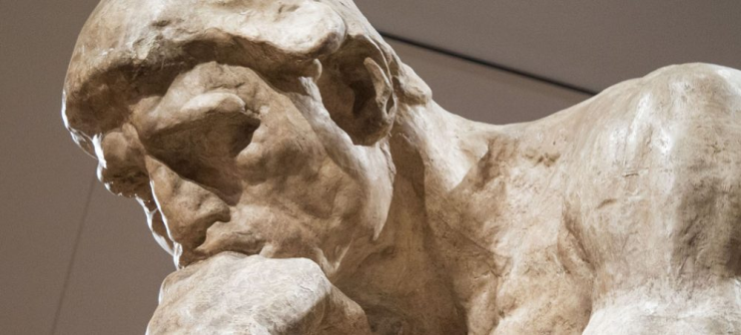
Dual Credit Opportunities
Advanced Placement (AP)
International Baccalaureate (IB)
Post Secondary Enrollment Options (PSEO)
Project Lead The Way (PLTW)
MCTC College Now Math
MN Bilingual Language Seal

Slide 7
Articulation Examples
University of Minnesota
Accepts IB Higher Level scores of 5 or above for credits (8 cr)
Accepts AP scores of 3 or above for credit (3-4 cr)
Accepts PSEO credits
MNSCU schools (i.e. St. Cloud, Mankato, Winona)
Accepts IB Higher Level scores of 4 or above for 3 credits. Accepts IB Standard Level scores of 4 or above for 2 credits.
Accepts AP scores of 3 or above for credit (3 cr)
Accepts PSEO credits

Slide 8
Application: U of MN
April 7 Deadline (one enrollment period for year); May 30th notification.
500 admitted students out of 1200 applicants. Typical Acceptance: GPA ≥ 3.89 with rigorous courses.
Info sessions: 2/20; 3/1 or 3/7 @ 5:30 Bell Aud.
Step 1: Complete on-line application
Step 2: Pick up paperwork from counseling office
Balance Sheet (credit needs)
PSEO Notice of Registration
Step 3: Mail all materials to U of M
Placement testing for Math and World Language after admission

Slide 9
Application: Minneapolis Community and Technical College (MCTC)
June 1st / December 1st Deadlines
Juniors: 3.0 GPA and test college level on the Accuplacer Test*
Seniors: 2.5 GPA and test college level on the Accuplacer Test
Step 1: Complete online application
Step 2: Take the Accuplacer test and bring results to your counselor. The Accuplacer tests your Reading Comprehension and Mathematics; prepare before you test!
Step 3: Pick up balance sheet, transcript, Notice of Registration Forms.
Step 4: Mail all materials to MCTC
*Testing note: You may use your ACT score if you have ≥ Reading: 21; English: 18; Math: 22

Slide 10
Normandale Community College
Application deadlines: July 1st and Dec. 1st
Juniors: Top 1/3 of class or 70th percentile on PSAT
Seniors: Top 1/2 of class or 50th percentile on PSAT
Step 1: Pick-up application in counseling office.
Step 2: Complete application and mail in with transcript and counselor signed form.
Step 3: Take the Placement Tests at Normandale (Reading, Writing and Mathematics) if ACT scores not high enough
Informational Sessions: 2/2, 3/1 5:00pm

Slide 11
Sophomore Eligibility
High school sophomores need to meet the course prerequisites and have earned a “meets” or “exceeds” proficiency level on the 8th grade reading Minnesota Comprehensive Assessment (MCA) test.
Students may take one approved Career and Technical Education course in a CTE program of study (examples include Business Management, Graphic Design, HVAC, Law enforcement).
If the student earns a C or better in that class, the following semester they can take more career and technical courses. If you continue to earn a C or better, you will be eligible to register for general education classes as a Junior and Senior.

Slide 12
PSEO: High School vs. College
HIGH SCHOOL
Teachers often remind you of due dates and assignments.
Teachers check your completed work.
Testing is frequent and covers small amounts of material.
Teachers often arrange tests so as not to conflict with school events.
“Good faith” is often rewarded with a higher grade.
Classes meet every day.
Access to student information.
COLLEGE
Professors expect you to read, save, and consult syllabus for due dates.
Homework is not often given and rarely checked or used for grading.
Testing is infrequent, cumulative, and encompasses a large part of your grade.
Tests are scheduled without regard for other classes or activities.
Reading load is much heavier than high school.
“Good faith” effort is appreciate but typically doesn’t change the grade you earned.
Classes meet two or three times a week.
No parent access to student information.

Slide 13
Final Considerations for PSEO
Maintain close contact with WHS counselor for scheduling WHS classes, college course approval, and other important information.
All college grades added to WHS transcript.
Any C- or less likely will result in probation.
Transfer of credits subject to discretion of receiving institution.
Part-time students must be aware of the 2nd semester timing differences between college and WHS; classes may conflict.
College credit conversion: X (college credit) x .25 = WHS Credit ex. 4 credit college = 1 WHS credit

Slide 14
PSEO Application Steps Summary
Step 1. Pick up application materials in WHS Counseling Office or download/apply directly through college website.
Step 2. Submit all required materials (official sealed transcript, Notice of Registration Form, and when required, exams/balance sheets).
Step 3. Take Placement Tests (MCTC, Normandale if ACT scores not high enough)
Step 4. Notify your counselor ASAP of acceptance
Step 5. Attend orientation and registration session
Step 6. Attend WHS group scheduling session in June
Step 7. Meet with WHS counselor to approve credits and review
WHS schedule (early to mid-August).

Slide 15
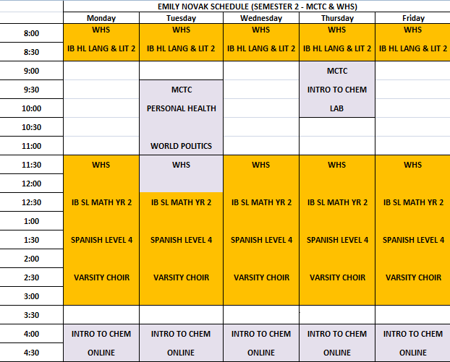

Slide 16
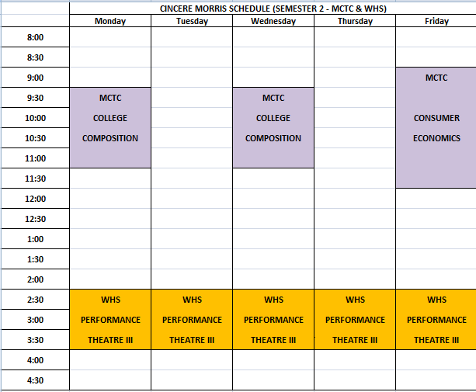

Slide 17
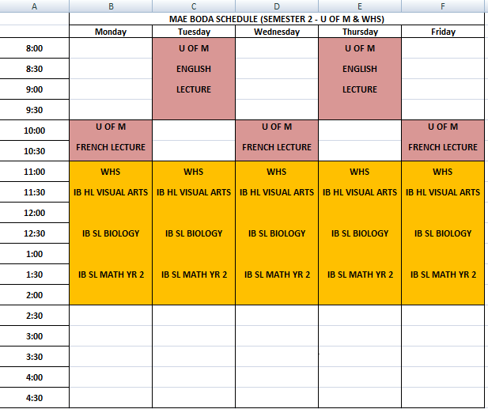

Slide 18
