Slide 1
Welcome!
2018-19 New Family Orientation

Slide 2
Agenda
Welcome! People to Know
Washburn 101
Tips for Student Success
Support Services and Programs

Slide 3
People to Know
Administrators
Dr. Emily Palmer, Principal
Ms. Shannon Tenner, Assistant Principal (Grade 9)
Ms. Michelle Terpening, Assistant Principal
Mr. Michael O’Connor, Admin TOSA

Slide 4
People to Know
Counselors
Loretta Collins A-C (grades 9-11); A-D (12)
Herb Crowell D-Hug (grades 9-11); E-J (12)
Amy Webster Huh-Mod (grades 9-11); K-M (12)
John Pemberton Moe-Sam (grades 9-11); N-Sa (12)
Teresa Savage San-Z (grades 9-11); Sc -Z (12)
Career and College Center (CCC) Coordinators
Danielle Seifert Grades 9 -12
Munira Mohamed Grades 9-12 (Monday and Tuesday)
Advanced Academic Coordinator
Aaron Percy

Slide 5
People to Know
School Nurse
Denise Schneider
Dean
Giovan Jenkins, Grade 9
Social Workers
Marisa Gustafson, Grade 9 (A-K) and Grade 10
John Jubenville, Grades 11, 12
Nicole Sellin, Grade 9 (L-Z) & students in Fed. Setting III and Autism program
School Psychologist
Jason Kurtz, 504 Manager

Slide 6
Take a breath...

Slide 7
1st Day of School: August 27th
Students in grade 9 report to the Auditorium for a welcome assembly
Students in grades 10-12 report directly to class

Slide 8
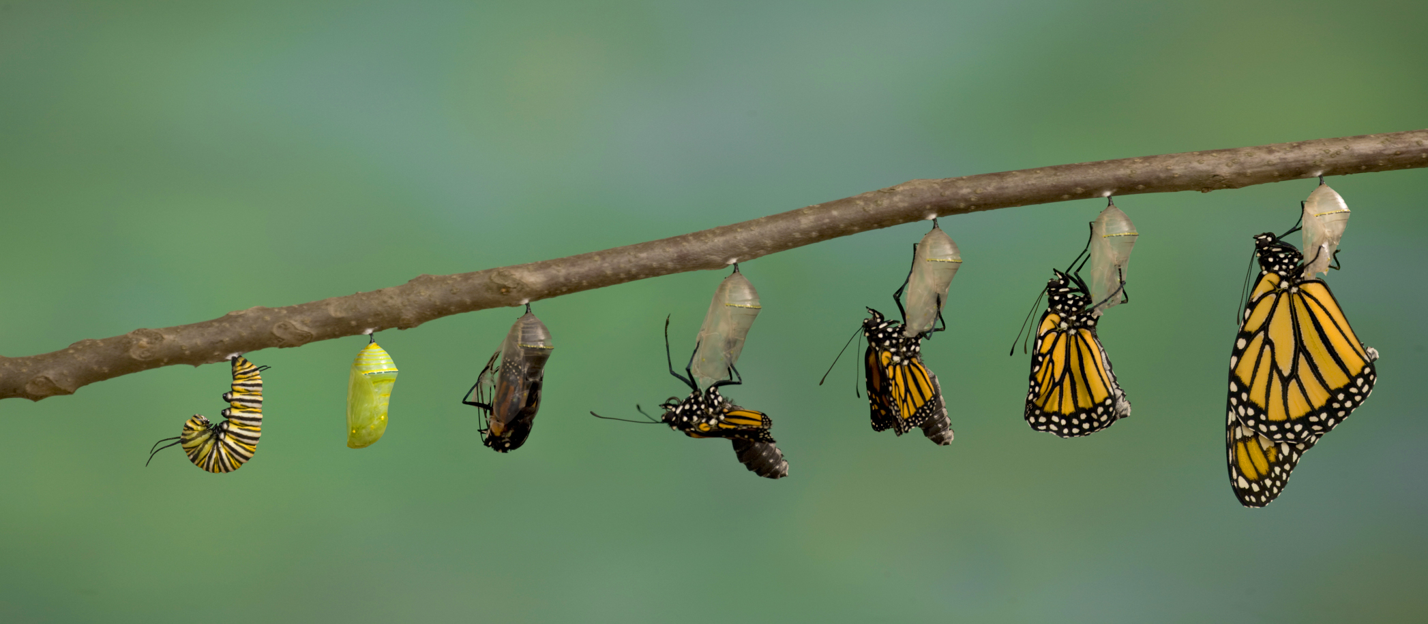
Schedule Changes
If you received a class you didn’t ask for, even as an alternative choice, or feel you are in the wrong level class, you may request a schedule change.
Forms must be submitted by the student and returned to the counseling office by Fri, Aug 31.
Changes will be very limited.
All schedules will be final Tue, Sept 4.

Slide 9
Washburn 101
Main entrance is Door #10 (50th street)
Students can use their printed schedules to get into the building until they receive their ID cards. ID’s are distributed about two weeks after school starts. Lost card fee is $5; check with your Dean.
Picture day is Aug 31

Slide 10
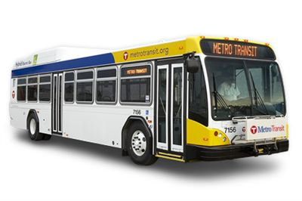
Go-To (bus) pass
Cards are valid from 5 a.m. to 10 p.m., 7 days a week
Go-to Card Distribution for eligible students*
-Aug 22 from 9:00 a.m.–2:00 p.m.; Grade 9 only
-Aug 23 & Aug 24 from 9:00 a.m.-2:00 p.m.; Grade 10-12
*Eligible students:
-On free or reduced lunch and within the 2 mile walk zone;
-Students who are transportation eligible
Not eligible for a free pass? You may purchase for
$82.50 per quarter or $330 per year

Slide 11
Meals
Breakfast is for all students from 7:45-8:10 am (free)
Students are assigned to one of three lunches based on their 4th hour teacher. Students will learn which lunch they have on the first day.
9th Graders must eat in the cafeteria. 10th-12th graders have open campus for lunch.

Slide 12
Bell Schedule
Period |  | Start | End
Zero |  | 7:30 | 8:25
1 |  | 8:30 | 9:25
2 |  | 9:30 | 10:25
3 |  | 10:30 | 11:25
4 |  | 11:30 | 1:00
 | Lunch 1 | 11:30 | 12:00
 | Lunch 2 | 12:00 | 12:30
 | Lunch 3 | 12:30 | 1:00
5 |  | 1:05 | 2:00
6 |  | 2:05 | 3:00

Slide 13
Washburn 101 (continued)
Appropriate Dress
No bare midriffs, exposed cleavage, exposed underwear, or any clothing with words or images that promote profanity, illegal substances, sex, harassment, or gang affiliation.
Personal Electronic Device policy
-No use/no access from bell to bell.
- Electronics are permitted in hallways during passing time and in the cafeteria.

Slide 14
Attendance

Slide 15
Absences
Guardian must call Ruby Hall, attendance clerk @ 612-668-3429,
between 7:00 a.m. – 10:00 a.m. on the day the student is absent;
If a call isn’t possible, the student should bring a signed note from a guardian to the attendance office upon returning to school

Slide 16
Questions about classes/progress
Curriculum night: September 26th @ 6:30 pm
http://parentportal.mpls.k12.mn.us
Contact your student’s teacher through e-mail

Slide 17
Grade Reporting
Quarterly grades are given and become part of student’s permanent record (transcript)
-Quarters end: Oct 31, Jan 23, March 28, June 7
Progress reports are mailed home at mid-quarter
There are 2 conference events each year:
-Oct 16/17 and Feb 14/15
-No appointments are taken for conferences

Slide 18
Standardized Testing
Testing is required of us for federal and state funding. Counselors work with all students to ensure they have taken a standardized test that is required for admission for their college or career path.
9th: MAP
10th: MCA Reading, MCA Science, PSAT (optional)
11th: MCA Math, MCA Science, PSAT (optional), ACT at Washburn for all, National ACT dates (optional)
12th: National ACT dates (optional)

Slide 19
Student tips for success
Get involved
Explore interests
Self-advocate
Seek balance
Stress Management
Embrace the journey

Slide 20
Support Systems
Academic
Peers
After-school help from your student’s teacher
Before school and after school tutoring
Students with IEP’s: Case Manager
Students with 504’s: Jason Kurtz, School Psychologist
All students: School Counselor
Khan Academy: khanacademy.org

Slide 21
Support Systems (continued)
Social/Emotional
Counselors
Social Workers
School-Based Clinic
Medical (sports physicals, immunizations, treatment of minor illness and injury, reproductive health)
Mental Health
Social work
Nutrition and health education
Check and Connect
Community Safety: Police Liaison Officer Barnes

Slide 22
Family Communication
General Information
Washburn website: http://washburn.mpls.k12.mn.us/index
Weekly or Bi-Weekly newsletter from Erica Lebens-Englund, Parent Liaison (612-668-3440)
Conference night and evening presentations: Topic specific counselor and career center staff informational sessions.

Slide 23
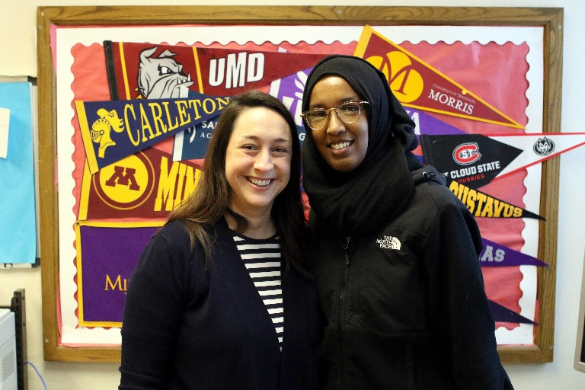
AchieveMpls Career & College Center (CCC)
AchieveMpls is a non-profit partner of M.P.S. and collaborates with the counseling team to provide additional career & college services.
The CCC is located in room #107 (located by door 10)
CCC is open M-F during the school day and after school
Coordinators:
Danielle Seifert (Mon - Fri)
Munira Mohamed (Mon & Tue)

Slide 24
Naviance
Naviance is a web-based resource that supports career and college planning. Email or call Danielle/Munira to set up your parent account.
In Naviance, students can:
create a post-secondary plan and complete My Life Plan milestones
take inventories to increase self-awareness
research career and college options
compare self with scattergrams
search scholarships
sign up for representative visits

Slide 25
CCC Resources and Tools
My Life Plan assists students with building their college and career plans. Naviance Family Connection houses every student’s college and career readiness plans/portfolio. Completing My Life Plan is a post-secondary planning graduation requirement.
CCC Newsletter is sent bi-weekly to families, students and staff with events and activities happening locally and in the AchieveMpls CCC. The CCC Newsletter is sent to students and families through Naviance. The CCC Newsletter is also posted on the Washburn website.
Rep Visits each year representatives from colleges, career, and the community visit the CCC to meet with students. We highly recommend that students, specifically juniors and seniors, take advantage of these visits. Students must sign up for visits ahead of time in Naviance and have a signed pass to attend.

Slide 26
CCC Resources and Tools
Washburn College Access Networks Washburn partners with different college access programs in the community to provide additional support for our students in achieving their post-secondary goals. We currently partner with St. Olaf TRIO Educational Talent Search, Normandale TRIO Upward Bound, Project Success (free college tours) and Genesys Works.
Step-Up Internship Program is the City of Minneapolis & AchieveMpls internship program for young adults ages 14-21. Step-Up trains and places hundreds of students in paid internships with top Twin Cities employers. Applications come out in December and are due in the beginning of February.

Slide 27
Counselor/CCC Events Grade 9
Grade 9 Content
Post-Secondary Planning | Date
New Family Orientation | August 22, 2018
Grade 9 Student Orientation (MLP classrooms) | September 10-14
MnACC College Fair | October 8, 2018
Academic and Post-Secondary Course Plan (MLP) | February 2019
Career Exploration Events | Yearlong

Slide 28
Counselor/CCC Events Grade 10
Grade 10 Content
Post-Secondary Planning | Date
Beginning of Year Check In (MLP classrooms) | October 8-12, 2018
ACT National Test | Yearlong
MnACC College Fair | October 8, 2018
PSAT/NMSQT | October 24, 2018
AchieveMpls Career Speakers Event (MLP classrooms) | December 5, 2018
Personality Types (MLP classrooms) | December 17-21, 2018
Advanced Academics Information | January 7-11, 2019
PSEO Student Panel | Winter 2019
Resume Building | Winter 2019
Academic and Post-Secondary Course Plan (MLP) | February 2019
Post-Secondary and Financial Aid Planning Night | April 11, 2019
Career Exploration Events | Yearlong

Slide 29
Counselor/CCC Events Grade 11
Grade 11 Content
Post-Secondary Planning | Date
Beginning of Year Check In (MLP classrooms) | October 8-12, 2018
Rep Visits | Fall/Spring- check Naviance for listings
ACT National Test | Yearlong
MnACC College Fair | October 8, 2018
PSAT/NMSQT | October 24, 2018
Career Interest Inventory (MLP classrooms) | November 26-30, 2018
Academic and Post-Secondary Course Plan (MLP) | February 2019
Career and Opportunity Fair | March 12, 2019
Post-Secondary Launch (MLP classrooms) | April 8-12, 2019
Post-Secondary and Financial Aid Planning Night | April 11, 2019
Career Exploration Events | Yearlong

Slide 30
Counselor/CCC Events Grade 12
Grade 12 Content
Post-Secondary Planning | Date
ACT National Test | Yearlong
Senior Post-Secondary Process (classrooms) | Yearlong
Fall Senior Counselor Meetings (MLP) | Fall
Rep Visits | Fall/Spring- check Naviance for listings
Senior College and Financial Aid Night | September 20, 2018
FAFSA/MN Dream Act Completion (MLP) | Opens October 1, 2018
MnACC College Fair | October 8, 2018
FAFSA/MN Dream Act Completion Workshop Nights | Fall: November 13, 2018/ Spring: February 12, 2019
Scholarship Search and Applications | Yearlong
Career and Opportunity Fair | March 12, 2019
Graduation Approval & Senior Exit Survey (MLP) | May 2019
Career Exploration Events | Yearlong

Slide 31
QUESTIONS?

