Slide 1

Class of 2017 College Planning Night

Slide 2

Overview
Introductions
College Search Philosophy
Admissions 101
Financial Aid 101
Developing Your List
Applying
College Application Timeline
Questions!

Slide 3
People to Know!
Counselors Works With
  Loretta Collins A-D
  Herb Crowell E-LA
  Amy Webster Le-Ra
  Teresa Savage Re-Z
  John Pemberton on special assignment
CCC Coordinators
  Eman Abdullahi All Students
  Danielle Seifert All Students

Slide 4
The College Search Philosophy
“College is a match to be made, not a
prize to be won. Finding a good fit requires
time and thoughtfulness.”
It’s all about the fit.
Where you go matters less then what you do once you are there.
Notes:
Cheesy aphorism; apochryphal stories
2000 4 year colleges; good education can be found at any of them
Focus on the experience in those 4 years. After 1st job or in grad school, no one cares where you went.
90% accept almost everyone; 50 say no more than yes
Parents priority- financial- need to have that talk; kids don’t understand amortization and loan payments – teaching? Private college?
Cost, size,majors,location, selectivity, public/private
“Americans love lists” -- # of applications, # of rejections brings status (do they crow about it)

Slide 5
ADMISSIONS 101
What are my options?
What do colleges want?
How do I get in?

Slide 6
Admissions 101
Types of Colleges
Types of Admissions Selectivity
4 year vs. 2 year
Small, Medium, Large
Public vs. Private
Urban, Suburban, Rural
Regional vs. National
Teaching vs. Research
Open
  All graduating students eligible
Selective
  Admissions process does not admit everyone
Highly Selective
  Admissions process denies more students than it admits

Slide 7
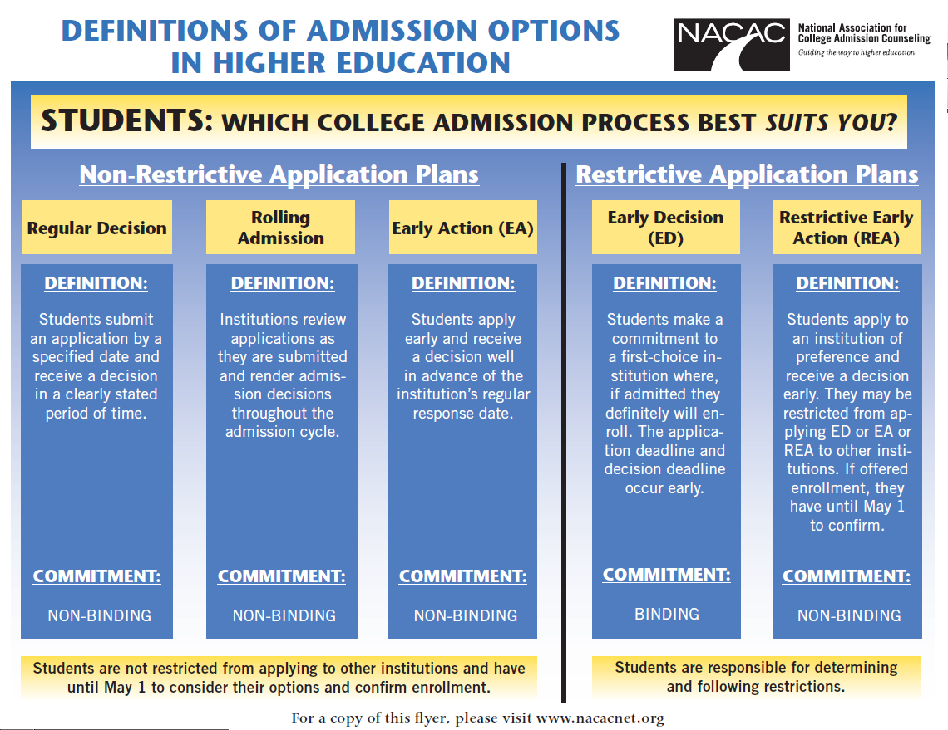
Admissions 101

Slide 8
Admissions 101
WHAT DO THEY WANT?
  Academic record (transcript)
    GPA
    Rigor of classes
  Standardized tests (ACT/SAT/SAT II)
  Essays
  Letters of recommendation
  Activities/Resume
Remember schools look to build a diverse and talented class that fits their needs.
Notes:
BY high school varies greatly as well
All in all, grades will outweigh tests 3.8/22 2.7/27
Essay- be yourself, no laundry list, parent shouldn’t write or heavily edit, not packaged

Slide 9
Admissions 101
WHAT ELSE DO THEY WANT?
  Interviews
  Personal qualities
  Interest shown in the school
    Visits
    Contact by student
  “Hooks”
    Athletics/Fine Arts
    Legacy
    Gender
    Geography
    Religion
Remember schools look to build a diverse and talented class that fits their needs.
Notes:
BY high school varies greatly as well
All in all, grades will outweigh tests 3.8/22 2.7/27
Essay- be yourself, no laundry list, parent shouldn’t write or heavily edit, not packaged

Slide 10
Financial Aid 101
How do we pay for it?

Slide 11
Financial Aid 101
  While Financial Aid can make college more affordable,
  most colleges will assume students and parents hold the primary responsibility for paying for college.
So…start the conversation early about your expectations for college finances.

Slide 12
Financial Aid 101
Ways to Pay for College
  Savings
  Current Income
  Grants
  Scholarships
  Work Study
  Loans
  Community or Military Service
Colleges will
consider these items financial aid!
Notes:
Blue Box at the Bottom? Necessary?

Slide 13
Financial Aid 101
Need-Based Aid
Scholarships
BASED ON YOUR NEED.
Grants
Student Work
Loans
BASED ON MERIT/ELIGIBILITY
Institutional
Local Community
National Scholarships
FAFSA and CSS Profile used to determine your need.
Cost of Attendance – EFC = Need

Slide 14
Financial Aid 101: Resources
MN, WI, ND, SD, Manitoba reciprocity
  www.ohe.state.mn.us
Midwest Student Exchange Program (IL, IN, KS, MI, MO,NE)
  http://msep.mhec.org/
Net Price Calculators
  All colleges must have them!
  http://nces.ed.gov/ipeds/netpricecalculator/
Notes:
Every one should do the FAFSA even if just to get a student loan. Could need to qualify for institutional scholarship.
In a divorce situation, only the parent who student lived with most of the year reports income on FAFSA.
Consider starting at a 2 year? 5000 yr.

Slide 15
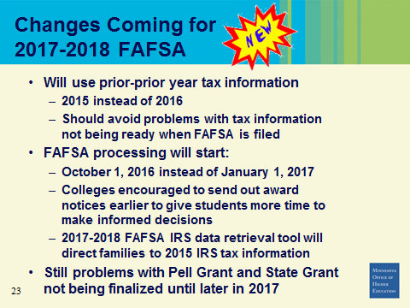
Financial Aid 101: Resources
Notes:
Every one should do the FAFSA even if just to get a student loan. Could need to qualify for institutional scholarship.
In a divorce situation, only the parent who student lived with most of the year reports income on FAFSA.
Consider starting at a 2 year? 5000 yr.

Slide 16
Developing Your List
But there are so many! How do I narrow it down?

Slide 17



Initial College Search
Start broad, then funnel down
Not eliminating options based on cost
  Be aware, but consider all options
  FAFSA estimators, Net Price Calculators
No “right/wrong,” just different priorities
  Rank priorities
  Remember that parents and students
  likely have different priorities…
Notes:
Look at profile of class from previous year
Don’t be afraid to apply to a lesser known school---merit aid?
Make sure the target school is not a really a reach school.
Kevin can tell story about his college search, the Princeton Review Guide, and the colored tabs.

Slide 18
Developing Your List
Determine your priorities—use checklist, use what you know!
  2 year vs. 4 year
  Cost
  Size
  Majors
  Academic Profile
  Location
  Public/private
Unsure on what you want?
  Visit different types of institutions!

Slide 19
Developing Your List
Other things to look for…
  Religious affiliation
  Social life
    Extra-curriculars
    Character of campus
    Fraternities and sororities
    Residential vs. commuter
  Student Support
  Graduation Rate
Even more to look for…
  Diversity
  Research/Internship Opportunities/Unique Programs
  Study Abroad
  Co-ed or not?
  Scholarship Opportunities
    Merit-based
    Need-based
Notes:
You can use anything that is important to you to help you narrow your search. Start visiting and writing down or noting reactions to campuses. Consider the experiences you want to have.

Slide 20
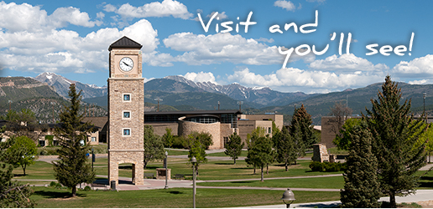
Developing Your List
Visiting Campuses is Powerful!
Set up your visit through a school’s admissions office.
Either call their visit line or book online!

Slide 21
Developing Your List: Visit
WHEN?
WHAT TO DO?
Spring Break
Summer
School Year
Get past the pretty pictures!
See it in person!
Visit Days vs. Individual
Classes
Tours
Talk with Students
Eat on campus
Meet with Coaches
Take a lesson
Overnights
See the local area
ASK QUESITONS!
WHY?

Slide 22
Developing Your List
Build a balanced list…
We suggest you have 5-7 schools that include:
  Reach
      Less than 30% chance of admission
  Target
      30%- 60% chance of admission/affordability
  Likely
      60%-90% chance of admission/affordability
Are you a good fit? (Educational, personal, social, financial)
Notes:
Look at profile of class from previous year
Don’t be afraid to apply to a lesser known school---merit aid?
Make sure the target school is not a really a reach school

Slide 23
Applying
I’ve got my list. How do I actually apply?

Slide 24

Applying
Follow step-by-step instructions for each college.
Common App
  One application used by 450 colleges
  Common essay; supplements
Coalition App (new)!
  private and public colleges and universities that commit to provide sufficient financial aid to meet the full, demonstrated financial need of every domestic student they admit
  90+ colleges
State Apps
  MNSCU system
School Specific Apps
  Offer alternative electronic or paper applications
Notes:
Hand out sheet
Early Decision- must be very sure, must pull all other applications, highly competetive, not good if you need lots of FA,
Early Action- better, not binding, still highly competitive

Slide 25

Applying: Naviance
WHAT IT IS
College Research
Scholarship Research
Test Prep! ACT course
Transmission of documents by WHS
Tracking of documents by family
HOW IT WORKS
Student as the Project Manager
Parent and Counselor as the support team
NAVIANCE as tool to facilitate the process
Notes:
Research: Interest Inventory, Personality Survey -- Major and Career Search, College Match, College Link, Admissions Data nationally and specifically from Washburn, Scholarship search.

Slide 26
Applying: Naviance
Washburn Home Page: www.washburn.mpls.k12.mn.us

Slide 27
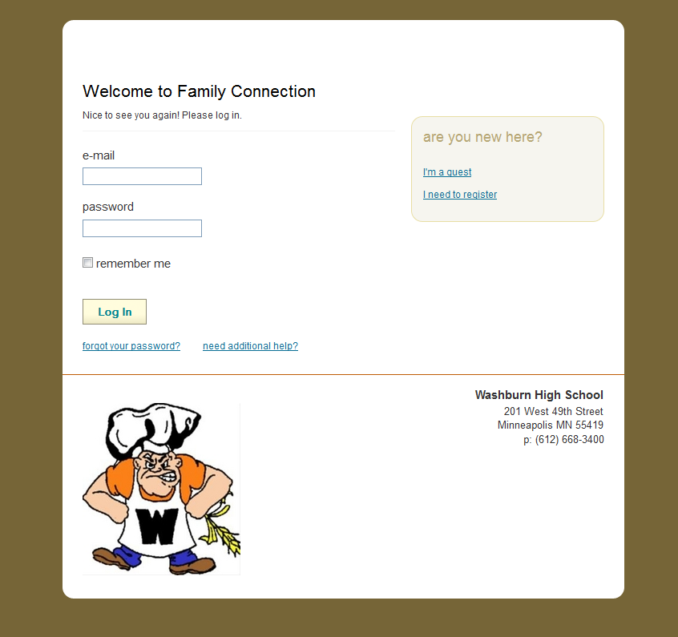
Applying: Naviance
Naviance Family Connection
How To Get Here
  Washburn Homepage
  Click on Parents
  Click on Naviance
  Sign In or Register!

Slide 28
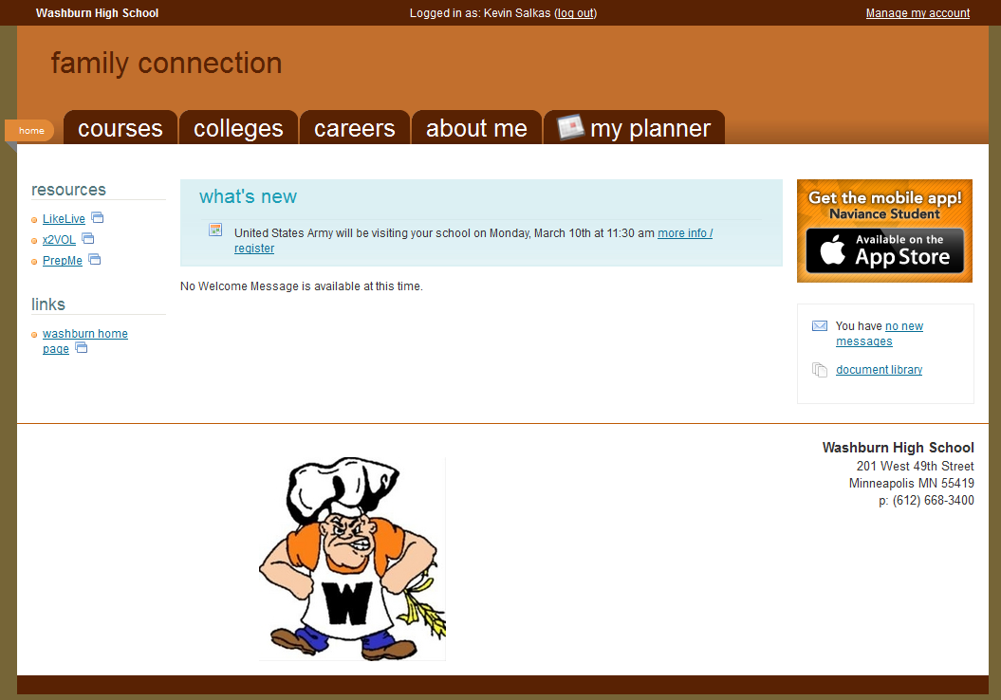
Applying: Naviance

Slide 29
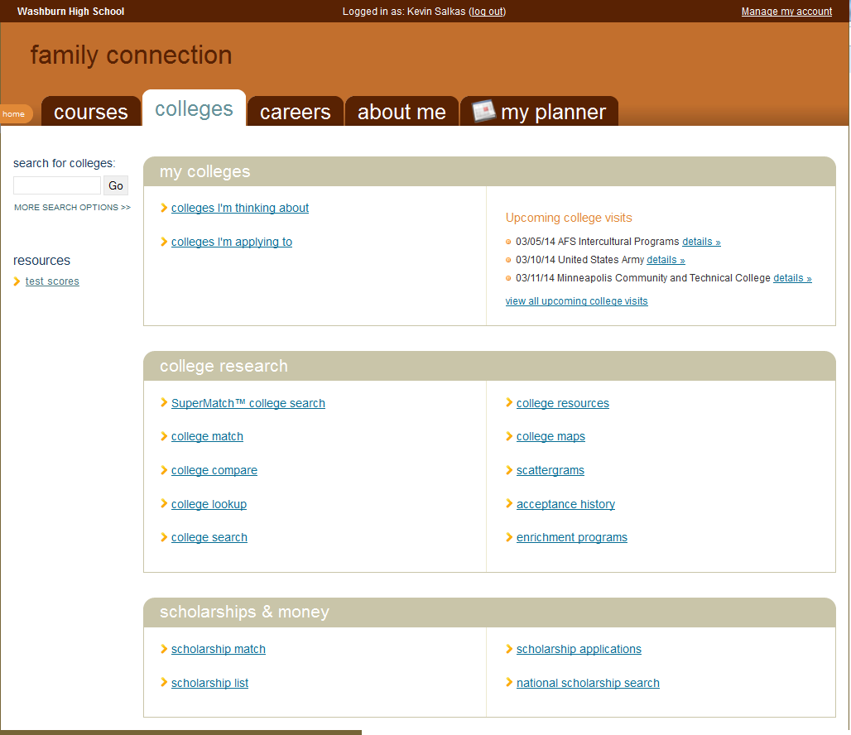
Applying: Naviance

Slide 30
College Application Timeline
What you should be doing. When you should be doing it.

Slide 31
Applying: Washburn Events
Junior Year:
April 4-8: College Search
May 20th: Post-Secondary Options Panel
Senior Year:
September Senior College Night
Sept-Dec: Weekly Presentations
October College Fairs
Early Winter: Financial Aid Workshops
These events happen at Washburn and are run by the counseling staff.
Notes:
Presentation 1- Overview of College Search Process
College Day- Private/Public school admissions, ACT strategies, Gap Year, Volunteerism, Military, Art Schools, 2 year colleges, Student Panel
Presentation #2- Essays, Recommendations, Summer ideas
Senior Weekly presentations- U of M, MNSCU, Private colleges, common-app, Essay, 2 year colleges, scholarships, FA Process

Slide 32
The next year…simplified.
Spring/Summer
Early Fall
Late Fall/ Winter
Search!
Build Your List
Visit schools
First Glance at Scholarships
Finalize List
Apply!
Visit schools of interest
Finish Applying
Apply for Financial Aid
Visit schools of acceptance!
Find/Apply for Scholarships

Slide 33

Application Timeline: Spring
Winter/Spring
  Start developing your list of colleges
  Use Naviance and other resources
  Prep for ACT/SAT
Spring Break
  Visit Colleges!
April - June:
  Take standardized tests (ACT, SAT, SAT II)
  Scholarship Search
  Consider Teacher Recommendations
  Division I and II Athletes register for NCAA clearinghouse
Notes:
CHECK DIVISION 2?

Slide 34
Application Timeline: Summer
Continue working on your college list, start to narrow it down.
    Online Tools
      Naviance
      ACT
      College Board
Work on Essays
Visit Colleges…Interview.
Try an EFC Calculator.
    Paper Tools
      Fiske Guide
      Insiders Guide To Colleges
      Ruggs Recommendations
      Princeton Review

Slide 35

How Do I Sign Up?
ACT
SAT
www.actstudent.org
March 15th at Washburn
  April 18th test
    March 13th registration
  June 13th test
    May 8th registration
  Future Dates
    September, October, December, February
Cost
  $56.50 ($39.50 w/o essay)
www.collegeboard.org
None offered at Washburn
  March 14th test
    Feb 13th registration
  May 2rd test:
    April 6th registration
  June 6th test
    May 8th registration
Cost
  $54.50 ($43 w/o essay)

Slide 36


Application Timeline: ACT/SAT
ACT PREP RESOURCES
Naviance Test Prep
Community Ed ($120)
CCC Books
Private Classes
Naviance Test Prep
CCC Books
Private Classes
SAT PREP RESOURCES

Slide 37
QUESTIONS?

