Slide 1
College Admissions Testing

Slide 2
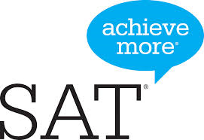
What are ACT and SAT?
College Admission Tests
American College Test (ACT) by ACT
Scholastic Aptitude Test (SAT) by CollegeBoard

Slide 3
Why Colleges Want the ACT/SAT
National standard measure of ability
High School Variability
GPA measurements
Course offerings
One of the only standard measures
Other options are typically content driven
AP
IB
CLEP
SAT II (Subject tests) – required in the application process at some of the most selective colleges in the nation: MIT, Williams College, Harvey Mudd
NOTE: Colleges will look at transcripts, test scores, extra-curricular activities, recommendations, and essays.

Slide 4
Why Take the ACT or SAT?
Usually required for 4-year college entrance
Academic Placement
Scholarship Opportunities
NOTE: Colleges will look at transcripts, test scores, extra-curriculars, recommendations, and essays.

Slide 5
Which Do I Take?

Slide 6
The SAT: What is it?
3 Hours (+ optional 50 minute essay)
Reading 65 minutes; 52 questions
Writing and Language 35 minutes; 44 questions
Math 80 minutes; 58 questions
Total score is between 400 and 1600
(scores range from 200-800 per section)

Slide 7
The ACT: What is it?
2 hours and 55 minutes
5 sections
1 English Test (45 minutes)
1 Math Test (60 minutes)
1 Reading Test (35 minutes)
1 Science Test (35 minutes)
1 Optional Writing Test (40 minutes)
Composite Score between 1 and 36.

Slide 8
ACT vs SAT Key Differences
 | SAT | ACT
Why Take It | Colleges use SAT scores for admissions and merit-based scholarships. | Colleges use ACT scores for admissions and merit-based scholarships.
Test Structure | Reading Writing & Language Math Essay (Optional) | English Math Reading Science Reasoning Essay (Optional)
Length | 3 hours (without essay) 3 hours, 50 minutes (with essay) | 2 hours, 55 minutes (without essay) 3 hours, 40 minutes (with essay)
Reading | 5 reading passages | 4 reading passages
Science | None | 1 science section testing your critical thinking skills (not your specific science knowledge)
Math | Covers: Arithmetic Algebra I & II Geometry, Trigonometry and Data Analysis | Covers: Arithmetic Algebra I & II Geometry and Trigonometry
Calculator Policy | Some math questions don't allow you to use a calculator. | You can use a calculator on all math questions.
Essays | Optional. The essay will test your comprehension of a source text. | Optional. The essay will test how well you evaluate and analyze complex issues.
How It's Scored | Scored on a scale of 400–1600 | Scored on a scale of 1–36

Slide 9
ACT vs. SAT: Key Differences
ACT
SAT
Scored 1-36
Composite is averaged from the sub-scores.
Sub-scores = score from each part
English (1-36)
Reading (1-36)
Math (1-36)
Science (1-36)
National Average = 21
Scored 400-1600
Score is totaled from the different sections.
Writing & Reading
200-800
Math
200-800
SAT II Subject Tests if needed
National Average = 1000

Slide 10
9th Grade
Other than AP tests, if applicable, standardized testing shouldn’t be a focus.
Develop good study and test taking habits
Seek help when needed
Learn to self-advocate
Develop and hone strengths, passions and interest
The PLAN (pre-ACT) is discontinued

Slide 11
10th Grade
The PLAN (pre-ACT) is discontinued
Register and take the PSAT in the fall
Cost was $20.00 fall 2016
Use as a prep tool
Register and take AP exams as applicable

Slide 12
11th Grade
Take PSAT in the Fall
National Merit Scholarship Qualifying Test
Prep for ACT
ACT test w/ writing at Washburn:
February 28, 2017
Set a testing goal, practice and re-take the ACT: April 8
June 10
Sept 9
Oct 28

Slide 13
12th Grade
Prep, practice and re-take the ACT if needed:
September 9
October 28
December 9
SAT II Subject tests
Math and Science most common
Highly Selective schools or specific majors/programs; MIT, Williams College, Harvey Mudd
Accuplacer test
Admission and placement at Community Colleges and Technical Schools, some MNSCU schools as well.

Slide 14
How Do I Sign Up?
ACT
SAT
www.actstudent.org
February 28th at Washburn
April 8 test
March 3 registration
June 10 test
May 5 registration
Future Dates: Sept, Oct, Dec
Cost
$58.50 ($42.50 w/o essay)
www.collegeboard.org
None offered at Washburn
March 11 test
Feb 10 registration
May 6 test:
April 7 registration
June 3 test
May 9 registration
Cost
$57.00 ($45.00 w/o essay)

Slide 15
Should I Take A Test More than Once?
Many students do better the second time.
57% increased their Composite score on the retest with no additional prep or practice
21% had no change in their Composite score on the retest
22% decreased their Composite score on the retest
May help overcome jitters.
Better preparation the second time around.
In between is a chance to practice on weaknesses.
Should I take the ACT 10 times?
NO. Scores pretty much settle after the 2nd or 3rd time.

Slide 16
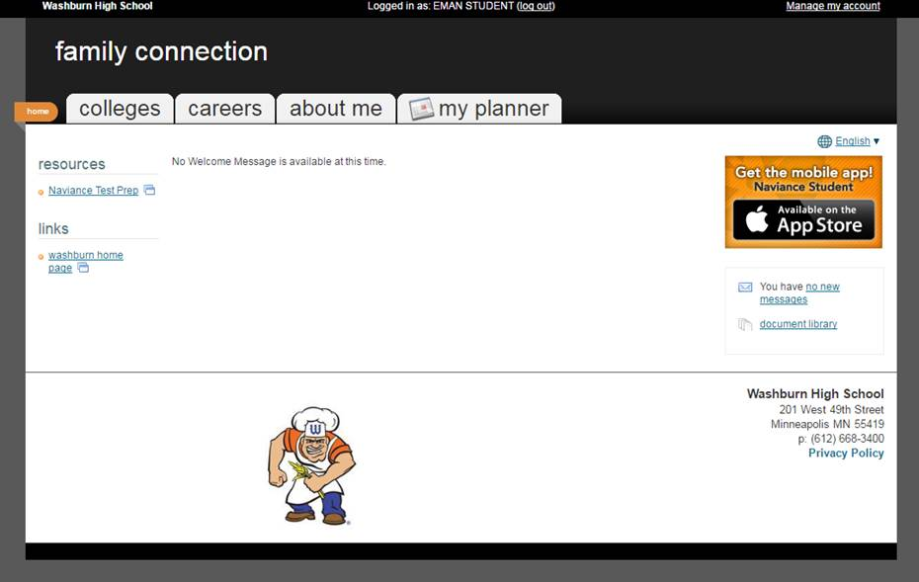
How Can I Improve My Scores?
Naviance ACT Test Prep
Course: Free, can start anytime

Slide 17
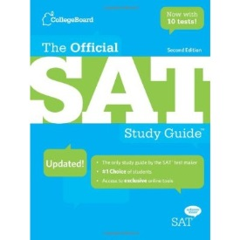
How Can I Improve My Scores?
www.khanacademy.org/test-prep/sat
Prep Guides
Free to check out at library and CCC
$30+ to purchase
MPLS Community Ed Course @ Washburn
$140
Offered in May
Private Tutoring
Sylvan, Huntington, Kaplan, etc.
Ranges from $500-$5000.

Slide 18
Should I Send My Scores?
ACT
SAT
Send up to 4 schools for free.
Students can choose which scores each college or university sees.
Can send up to 4 scores for free.
Sending a score sends all SAT scores to the selected colleges.
Most colleges and universities will use your highest score.
Some will even super score.
It is expensive to send scores later
ACT- $12.00 per test date per college/university
SAT- $11.25 per test date per college/university

Slide 19
Average Test Scores WHS students 2012-2016
College | Average GPA | ACT Average Score
U of M, Twin Cities | 3.71 | 27
University of St. Thomas | 3.59 | 24
Hamline University | 3.46 | 22
Luther College | 3.56 | 25
Gustavus Adolphus | 3.60 | 25
Augsburg College | 3.30 | 22
MSU, Mankato | 3.13 | 21
St. Cloud State | 3.13 | 21
U of M, Duluth | 3.43 | 24
Carleton College | 3.86 | 31
UW, Madison | 3.80 | 29
St. Olaf | 3.63 | 27
Iowa State | 3.45 | 25
Macalester | 3.86 | 29

Slide 20
Standardized testing not a strength?
Fairtest.org
Searchable database listing the 850 colleges and universities in the U.S. that don’t require standardized testing as part of the application.
Great colleges are included. Examples:
Gustavus, Lewis and Clark, University of Puget Sound, Lawrence University
Search more at:
http://www.fairtest.org/university/optional

Slide 21
The End
QUESTIONS?

