Slide 1
Minnesota State Schools and the university of Wisconsin system

Slide 2
4 Year Minnesota State Schools (MNSCU)
FYI: MNSCU = Minnesota State Colleges and Universities
State affiliated or funded colleges and universities that are more affordable than other public and private colleges and universities
There are seven MNSCU schools that offer 4 year degrees for students

Slide 3
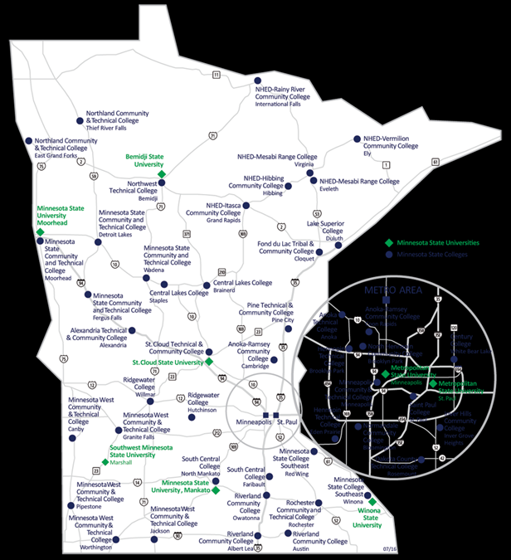
4 Year Minnesota State Schools
Bemidji State University
Metro State University
MSU - Mankato
MSU - Moorhead
St. Cloud State
Southwest Minnesota State
Winona State
There are also 30 two-year colleges in the MNSCU system that we will talk about in another class

Slide 4
MNSCU Fun Fact
Application fees waived 10/24-10/31 for ALL MNSCU Schools – check out the MNSCU website for more information!

Slide 5
Comparing Average Costs (per year)
MNSCU 4 year colleges- $13,000
UW System 4 year colleges - $15,000
U of M, TC- $24,000
U of M, Duluth- $20,000
Hamline- $40,000
St. Thomas- $39,500
Augsburg- $41,000
Carleton- $55,000
MN School of Business- $19,575 (No Housing)

Slide 6
Bemidji State University
Students: 6, 231 students (10% SOC)
Largest Programs: Tech Studies, Phy Ed, Education, Biology, Crim. Justice, Business
Unique Programs: Applied Eng, Aquatic Biology, Sports Management, Int’l Business, Veterinary Medicine, Pharmacy, Law, Medicine
Highlights:
Lakeside campus
Hew high tech nursing and science facilities
More than 65 majors and pre-professional programs
Environmental and global stewardship focus
Only 3% of classes have more than 50 students
60% have 20 or fewer students
17 to 1 ratio of student to faculty
Admissions: Top ½ of class or 21 on ACT

Slide 7
Metro State University
Students: 11,676 students (38% SOC)
Largest Programs: Individualized Studies, Business, Accounting, Criminal Justice, Nursing
Unique Programs: Computer Forensics, Criminal Justice, Law Enforcement, Theater, Education
Highlights:
Student population more ethnically and generationally reflective of Twin Cities
Daytime, evening , and weekend classes
1 main campus and several other campuses throughout metro area
Many options for on-line learning and credits through non-classroom experience
No Housing
Admissions: Top ½ of class or 21 on ACT or 3.0 GPA

Slide 8
MSU - Mankato
Students: 18,000 students (13% SOC)
Largest Programs: Nursing, Elementary Ed, Biology, Law Enforcement, Business
Unique Programs: Athletic Training, Automotive Engineering Technology, Construction Mgmt, Civil Eng, Comp Eng, Dental Hygiene, School Psychology
Highlights:
Many new campus buildings
Large exercise facilities, “Tech Rec” (40 machines with internet and cable)
Very active theater department
Competitive athletic program
Admissions: Top ½ of class or 21 on ACT w/ satisfactory class rank
Alternate admissions process for those who do not qualify

Slide 9
MSU - Moorhead
Students: 8, 930students (6.3% SOC)
Largest Programs: Business, Elementary Ed, Mass Communication, Biosciences, Art
Unique Programs: Athletic Training, Biotechnology, Construction Mgmt, Exercise Science, Film Studies, Music Industry, Graphic Communications, Pharmacy, Vet. Science, Physical Therapy
Highlights:
Award winning film studies program, theater, education, graphic design, construction
NDSU, Concordia nearby--- co-op courses
69 majors
Professors teach 99% of classes
Student-faculty ratio 19:1
73% classes have fewer than 30 students
Admissions: ACT of 21 or higher
OR a composite ACT score of 17-21 (inclusive) and either:
A high school class rank at the 50th percentile or higher, or
A high school cumulative GPA of 3.0 or higher
Call for alternate admissions process

Slide 10
St. Cloud State University
Students: 19,500 students (15% SOC)
Largest Programs: Mass Communications, Management, Marketing, Finance, Accounting
Unique Programs: Engineering Mgmt, Hydrology, Latin American Studies, Meteorology, Real Estate, Travel and Tourism, Medical Technology, Women’s Studies, Chiropractic, Dental Hygiene
Highlights:
200 Undergraduate programs
Award winning student newspaper, radio and TV Station
Close to the Twin Cities
One of the nation’s largest producers of teachers
Admissions: ACT 21 or higher OR top ½ of graduating class

Slide 11
Southwest Minnesota State
Students: 8,873 (8% SOC)
Largest Programs: Business, Education, Phy Ed, Hospitality Management, Marketing
Unique Programs: Culinary Arts, Global Studies, Radio and Television, Professional Writing, Pre-Dentistry, Mortuary Science, Forestry, Pre-Optometry, Agronomy
Highlights:
Leader in Agricultural Studies
New Rec Facility and Student Plaza
Unique coed and themed dormitories available
Renovated science labs
Small class sizes
Admissions: Top ½ of class or 21 on ACT
Alternate admissions – contact school for more information

Slide 12
Winona State University
Students: 9,549(9% SOC)
Largest Programs: Nursing, Elementary Ed, Business, Biology, Exercise Science
Unique Programs: Child Advocacy, Materials Engineering, Aviation Science, Music Business, Graphic Design, Pre-Vet Medicine, Pre-Dentistry, Pre-Pharmacy
Highlights:
Ranked as top public institution by various periodicals
Free-laptops and wireless access
82 majors
Leader in health care education
Competitive sports programs
Admissions: 21 on ACT top ½ of class or 3.0 GPA
APPLY EARLY!

Slide 13
The UW System
The UW System includes 13 comprehensive universities and 13 two-year colleges (UW Colleges)
The UW Colleges is an institution of access. New freshmen are likely to be admitted if they rank in the top 75% of their class. Similar to Minnesota’s two year colleges.

Slide 14
UW Universities
There are thirteen comprehensive universities in the University of Wisconsin System that grant baccalaureate and master's degrees:
UW–Eau Claire
UW–Green Bay
UW–La Crosse
UW – Milwaukee
UW - Madison
UW–Oshkosh
UW–Parkside
UW–Platteville
UW–River Falls
UW–Stevens Point
UW–Stout
UW–Superior
UW–Whitewater

Slide 15
UW Universities – Fast Facts
Eau Claire
Average ACT 22-27
Average percentile: 62nd-86th
Priority deadline: 12/1
Average cost of attendance: $15,000
La-Crosse
Average ACT 23-26
Average percentile: 69th-90th
Priority deadline: 2/1
Average cost of attendance: $17,000

Slide 16
UW Universities – Fast Facts
Milwaukee
ACT score of 21 or higher or top ½ of class preferred
Priority deadline: 3/1
Average cost of attendance: $17,000
River Falls
ACT score of 22 or in top ½ of class preferred
Rolling deadline: APPLY EARLY!
Average cost of attendance: $15,000
Stout
ACT score of 22 or higher or in top ½ of class
Rolling deadline: APPLY EARLY!
Average cost of attendance: $16,000

Slide 17
Take Aways
MNSCU and UW System schools are more affordable than most other public and private colleges and universities
Research them: They share similarities but all have their own personalities
Apply early
Talk to your counselor or stop in the CCC for more information

Slide 18
Additional Information
Check Naviance to sign up for visits (upcoming visits)
Winona State 10/28
UW-Milwaukee 11/11
UW- Green Bay 11/15
Washburn College Fair 11/8 (next slide will have more information)
Apply to MNSCU schools: www.mnscu.edu
(Remember: Free application to MNSCU schools from 10/24-10/31)
Apply to UW schools: https://apply.wisconsin.edu/
DON’T FORGET: send ACT scores to schools

Slide 19
Washburn College Fair
Washburn College Fair is Tuesday, November 8th, 9:00-10:30am in the main gymnasium
Teachers will bring their classes down to talk with more than 50 college representatives
MCTC, U of M, Gustavus, NDSU, UW-Eau Claire, Winona, and almost all other colleges in the area will be there!

