Slide 1

The College Application Process

Slide 2

People to Know!
Counselors Works With
  Loretta Collins Last Names A-D
  Herb Crowell Last Names E-J
  Amy Webster Last Names K-M
  John Pemberton Last Names N-Sa
  Teresa Savage Last Names Sb-Z
CCC Coordinators
  Danielle Seifert All Students
  Munira Mohamed All Students

Slide 3
Roles
Student
    Project Manager (aka “The Application Doer”, “The Appointment Maker”, “The Requester of Letters”)
Parent
    Provide supporting conversations
    Providing reality checks (financial resources, fit)
Counselor/Career Center Coordinator
    Answer questions
    Provide resources
    Send transcripts and forms/writing letters/assisting teachers
    Provide reality checks

Slide 4
Apply! Order of Operations
  Step 1: Get organized and ask questions
  Step 2: Develop your college list
  Step 3: Start college applications
  Step 4: Meet with counselor
  Step 5: Send ACT or SAT test scores to colleges
  Step 6: Complete and track applications
  Step 7: Apply for Financial Aid
  Step 8: Apply for Scholarships
  NOTE: You should send pieces (ACT scores, teacher recs, etc.) of your application as you complete them

Slide 5

Step 1: Get Organized and Ask Questions
You will be making a leap into your future. You can do it.
Make informed choices
Engage with the process
Use your resources well
Remain calm and organized
The “best” school is the one that fits you best. There is no one single “best" school for you.

Slide 6

  Career and College Center (CCC)
  College search process (various websites/tools)
  College application requirements (back of sheet)
  CCC Weekly Newsletter
  NACAC National College Fair
    Wed. Sept. 27th 9am-12pm and 5-8pm
    Thur. Sept. 28th 9am-12pm
  UNCF HBCU Empower Me Tour
    Friday, Sept. 22nd 8:30-2pm
  MnACC College Fair
    Monday, Nov. 6th 9:30-11am
  Project Success College Tours
    Permission forms in the CCC
  Rep Visits to the Washburn CCC
    Sign up ahead of time in Naviance
Notes:
Danielle Fix

Slide 7
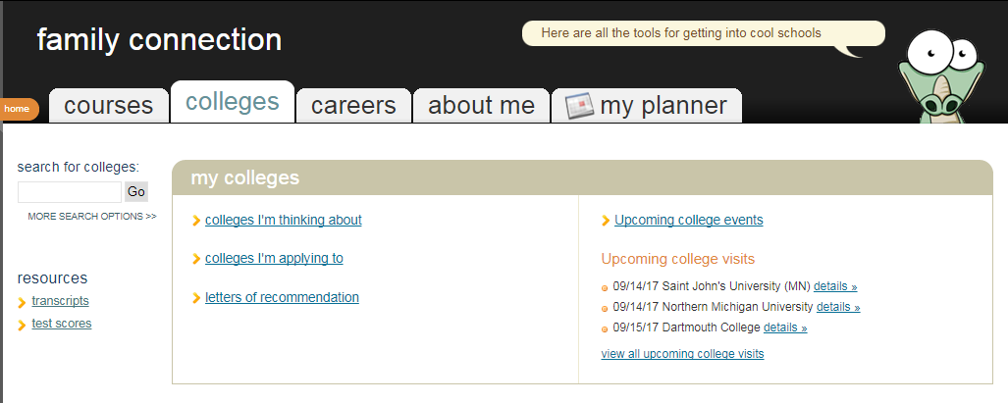
College Rep Visits

Slide 8
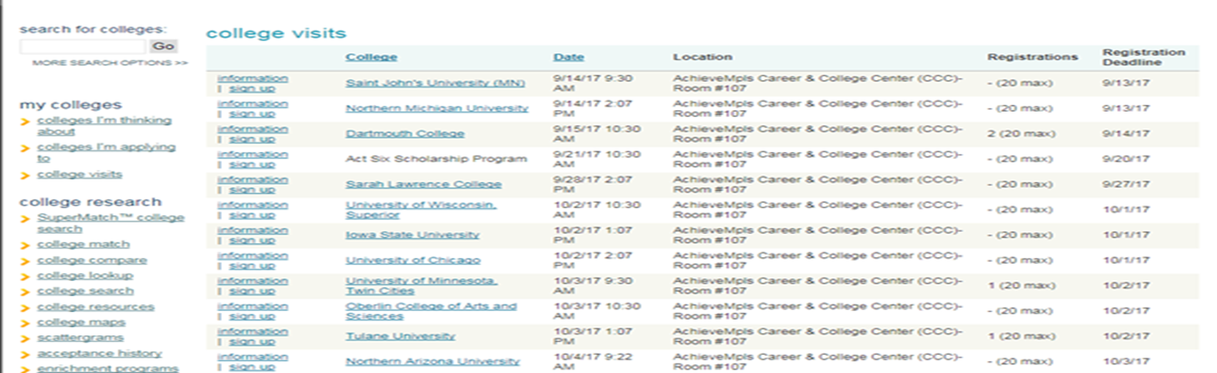

College Rep Visits

Slide 9
Step 2: Develop College List
A good school is one that is a good fit for you
A school where you will be happy, engaged, grow and that meet your needs
  Educational
  Personal
  Social
  Financial

Slide 10
Step 2: Develop College List
Likely – realistic
  Your profile is SIGNIFICANTLY stronger than the typical freshman
  60-90% chance of admission
Possible – selective
  Your profile is similar to the typical freshman
  30-60% chance of admission
Reach – more selective
  Your profile is not as strong as the typical freshman
  less than 30% chance of admission

Slide 11
Step 2: Develop College List
Factors in your “Objectively Important Profile” (published)
  G.P.A.
  Class Rank
  ACT or SAT Test Scores
Factors in your “Subjectively Important Profile” (unpublished)
  Rigor of Courses
  Activities/ Unusual Talent
  Diversity (Race, Ethnicity, Income, Geography)

Slide 12
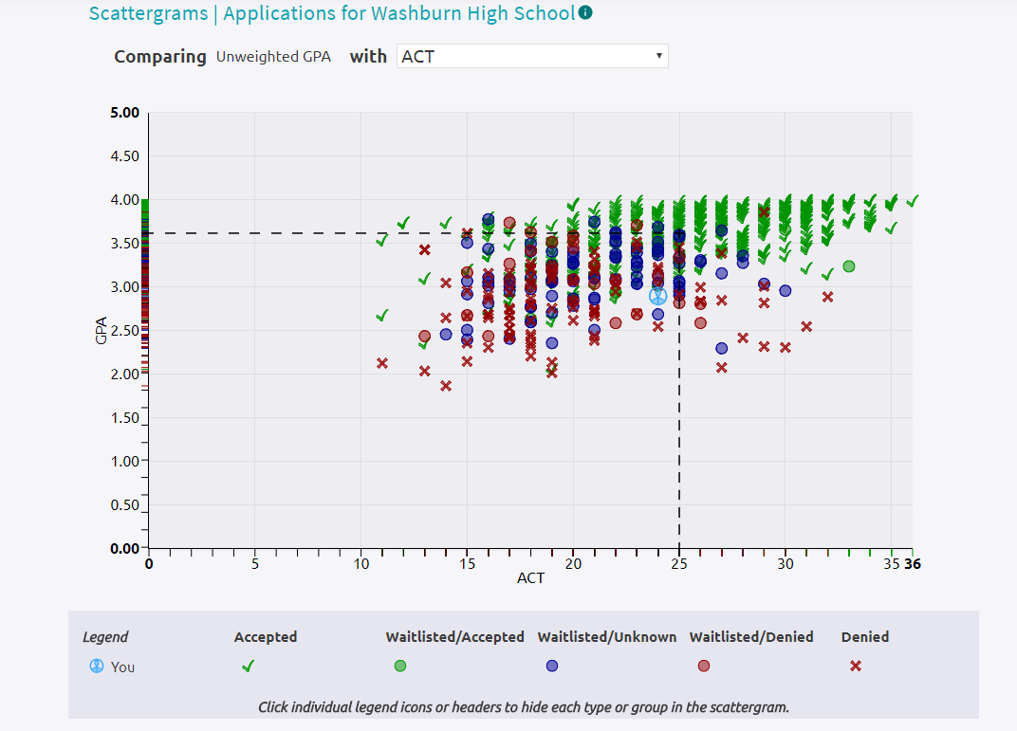

Scattergrams
Notes:
Pemberton Work

Slide 13
Step 3: Start College Applications
  Rolling Admissions
  Regular Deadline
  Early Action/Priority Deadline
  Early Decision (binding contract)

Slide 14
Step 3: Start College Applications
Be Professional!
  Appropriate grammar, punctuation
  Formal language; do not use texting/tweeting format
  Professional e-mail address
Student should apply; not the parent
Follow all directions

Slide 15
Step 3: Complete Your Applications
  Know which application methods will be the least time consuming.
    Institutional Application
      Minnesota State (i.e. St. Cloud, Mankato, MCTC)
      UW Schools
      Augsburg, St. Kate’s
    The Common Application
      University of Minnesota
    The Coalition Application

Slide 16
Essays
A good essay tells a story
A good starting point is a value, characteristic, accomplishment, skill, life event or interesting story that is important to you.
Great college essays connect to a deeper truth or something critical or essential to yourself.
This is a chance to tell an admissions office something you can’t cover with a test score, GPA, or activities list.
Examples:
  My big feet (Being comfortable with myself)
  Losing the race (Recognizing privilege)
  Grandma’s kitchen (How I was raised)
  Imaginary friend (My best ability is my imagination)
  Closet spider farm (Why I love science)

Slide 17
Essays
Extenuating/Special Circumstances
  Used to explain “abnormalities” on your transcript
  Only use if you have a valid reason that severely impacted your grades; be careful
  Check with counselor or CCC
  Don’t use this essay for excuses; explain what happened and how you grew into a better person/student as a result
Writing Lab (Media Center – Orange Lab)
  Get help with college and scholarship essays
  Sign up: Click on Help Request under the Students tab on Washburn website
  Hours: Before/After school and Lunch (need a pass)

Slide 18
Step 4: Meet With Counselor
  1. Schedule initial appointment in Counseling office
  2. Counselor will review prospective college options and load schools into Naviance.
  3. Counselor will:
    send transcript (*First three transcripts are free - pay $2 for each after)
    send school profile
    send academic evaluation form
    request for fee waiver (if applicable)
    add student name to teacher recommendation list (if applicable)
    *Teachers need at least 2-week notification
  4. Set appointment with counselor for interview (if applicable)

Slide 19
Step 5: Send ACT/SAT scores
Student is responsible for submitting ACT scores ($12 each) to all colleges if they were not sent at time of registration.
Send scores through actstudent.org
If attending a 2 year Minnesota institution, take the Accuplacer at the college.
  Accuplacer testing at Washburn may be available at the end of the year

Slide 20
Step 6: Complete and Track Applications
If you get an e-mail or postcard that says you are missing materials:
Step 1: Check Naviance to see what Washburn has sent to the college.
Step 2: Check college portal (if the college has one) to see if the college has received your materials.
Step 3: Check with Ms. Seifert or Ms. Mohamed in the CCC to help problem-solve.

Slide 21
Step 7: Apply for Financial Aid
Fill out your FAFSA at fafsa.gov or MN Dream Act at ohe.state.mn.us beginning October 1st, 2017
  UPDATE from OHE: (8/31/2017): While Deferred Action for Childhood Arrivals (DACA) program is being considered for elimination, we want you to know that the Minnesota Dream Act remains intact.
Continue to follow up with all financial aid offices and complete any financial aid verification processes
The CCC is available if you need help
FAFSA/MN Dream Act Application Workshops will take place during conference evenings (fall and spring)

Slide 22

Step 8: Apply for Scholarships
Did you know?:
  90% of scholarships are given from the attending institution
  Institutional scholarships can be awarded based off your college application
  Always make sure to check your college’s website for more institutional scholarship opportunities
Private scholarship opportunities:
  Naviance and CCC newsletter
  Most will be available starting in January
    i.e. Washburn scholarship

Slide 23
Senior Year Timeline
Fall: Applications
        9/21 Senior College and Financial Aid Night for Families
        9/27 & 28 National College Fair @ Convention Center
        10/28 ACT (register by 9/22)
        11/1 U of M application deadline
        11/6 MNACC College Fair @ Washburn
Winter: Scholarships/Financial Aid
        10/17 MN Dream Act FAFSA Workshop
        12/9 ACT (register by 11/3)
        2/1 Washburn Scholarship Applications distributed
        2/15 MN Dream Act FAFS Workshop
Spring: Graduation
        4/15 Financial Aid packages
        5/1 Make Final Decisions
        6/7 Graduation

Slide 24
Remember:
Make an appointment to see your counselor!!!
*Copies of this presentation will also be available on the Counseling website

Slide 25
Financial Aid
(FAFSA and CSS PROFILE) at
Washburn HS
Steve Lindley
Associate Director of Financial Aid
507-786-3521
lindley@stolaf.edu

Slide 26

Types of Financial Aid
Gift Aid:
Grants (need-based)
Scholarships (merit-based)
Self-Help Aid:
Loans
Student Employment/Work Study

Slide 27
Grants (need-based) vs. Scholarships (merit-based)
Scholarships (merit-based)
  Often from the institution but can be from foundations, scholarship organizations, etc.
  Have specific eligibility criteria
Grants (need-based)
  Calculated from financial aid application – evaluates family’s ability to pay for costs
  Sources can be federal, state, institutional
  Goal is to distribute limited resources in an equitable way
  Provide a balance of gift aid and self-help aid

Slide 28
Student Employment
Work-Study
Funding can come from institution or federal/state government
Typically students work up to 7-10 hours per week while enrolled
Paid hourly.
Have to work the hours to get paid.
  Funds may go straight to student or towards student’s account at the school

Slide 29
Loans
Student or parent debt
Must be repaid
Payments can be deferred while enrolled
Repayment typically 10 years
Students don’t need to borrow every dollar in their financial aid package
Repayment calculator available at http://www.studentloans.gov

Slide 30
Types of Loans
 | Interest Rate (2017-18 Year) | Repayment | Additional Info
Federal Stafford Direct Loan | Subsidized and Unsubsidized: 4.45% Fixed | 6 months after school | Subsidized: no interest charged while in school Unsubsidized: interest accrues while in school
Federal Parent PLUS Loan | 7.00% Fixed | May be deferred until 6 months after school | Interest accrues while student is in school Loan is in parent’s name
Alternative/ Private Loans | Fixed or Variable rate | Variable repayment terms | Interest accrues while student is in school Loan is in student’s name, but requires co-signer
Notes:
30

Slide 31
How is Aid Eligibility Determined?
The Free Application for Federal Student Aid (FAFSA)
  Required for federal, state and institutional aid programs
The CSS/Financial Aid PROFILE
    May be required by higher-cost, private colleges to determine eligibility for institutional aid programs
    Three schools in MN require the PROFILE:
      Carleton, Macalester and St. Olaf
College supplemental application
Always check with individual colleges to find out required applications and deadlines!

Slide 32
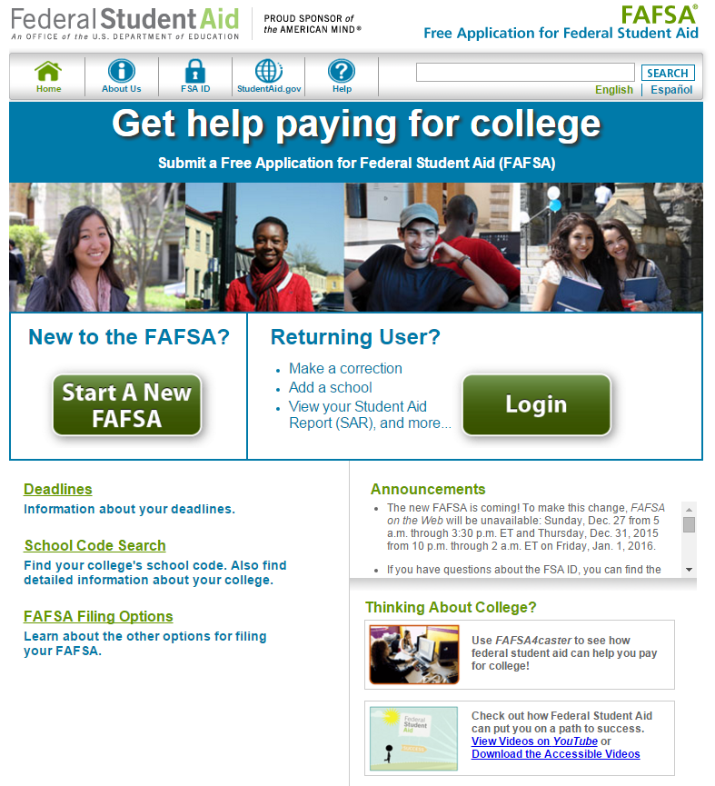
FAFSA on the Web www.fafsa.gov
Completing and processing the FAFSA is free!
NEVER pay a fee to file the FAFSA.
Complete the FAFSA after October 1st of your senior year
Have to file a new FAFSA every year

Slide 33
Information you need for the FAFSA
Financial
  Student
    W2s (if student worked)
    1040 (if student filed taxes)
  Parent
    W2s (if parent(s) worked)
    1040 (if parent(s) filed taxes)
    Information on assets
      Cash/savings/checking accounts
      Property (besides home)
      Business Value
Personal
  Student
    Name, date of birth, SSN, contact info
    Education history
    School FAFSA codes
  Parent
    Name, date of birth, SSN, contact info
    Marital status
    Household size and
    # of students in college
If parents are separated or divorced, only need custodial parent’s information.
Custodial parent is the parent that the student lives with more than 50% of the time

Slide 34
Be careful…
Put your name and SSN on FAFSA exactly how it appears on your social security card
Refer to completed federal income tax return and consult instructions for proper line references
If entry is zero or none, enter 0--don’t leave blank
Enter school code(s)
Student and one parent must both sign dependent student’s FAFSA
  Sign with FSA User ID and Password
  https://fsaid.ed.gov/
Notes:
34

Slide 35
Prior Prior Year?
Starting with the 2017-18 Academic Year, both FAFSA and the CSS PROFILE will move to asking for financial information for the prior, prior year
This means that the 2018-19 FAFSA/PROFILE will ask for 2016 financial information
Advantages
  Fill out forms earlier (FAFSA will start in October)
  Families will have final numbers
  Possibly have financial aid awards earlier?
Disadvantages
  More appeals due to using older data

Slide 36
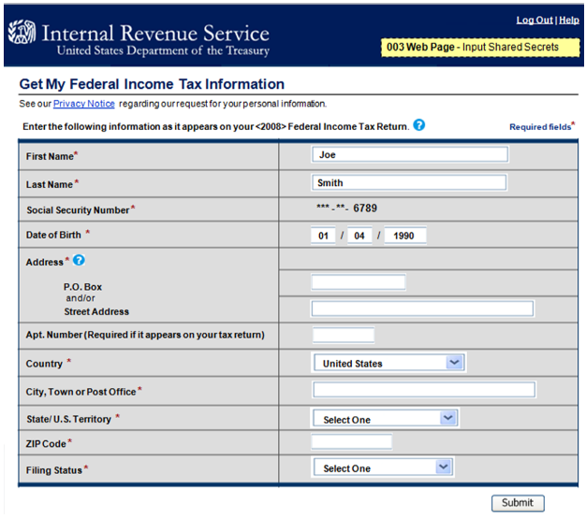
IRS Data Retrieval Tool
New option in 2012
Link to IRS website out of FAFSA
Information will be masked on the FAFSA.
  You will not be able to see the actual numbers.

Slide 37

Expected Family Contribution (EFC)
The EFC is an INDEX NUMBER calculated from the information you provide on the FAFSA according to a formula established by law.
It is NOT what you will actually end up paying for college!
You can get an estimate of your EFC using the FAFSA 4-caster tool at: www.fafsa.gov
Notes:
37

Slide 38
Student Aid Report (SAR)
Emailed to student a few days after FAFSA submitted
Will contain all the info you entered on FAFSA and the EFC
Look it over and check for mistakes
  Income of $780,000 instead of $78,000?
  If you find mistake, go back into FAFSA and correct the error

Slide 39
CSS PROFILE
Much more nuanced and in-depth financial aid form
Can be completed any time after October 1st
Cost = $25 for your first college
  Additional schools are $16 each
Automatic Fee Waiver does kick in for families below a certain income threshold
  Mostly families receiving government benefits such as free/reduced lunch

Slide 40
CSS PROFILE
Families will provide their 2016 information
  Will also ask for estimates of 2017 AND 2018
    These estimates are ESTIMATES, do they best you can but don’t worry about trying to be exact
Special Circumstances/Explanation Section

Slide 41
CSS PROFILE
Includes a lot of allowances for family income
  Allowances include:
    Retirement
    Future Education Needs
    Medical/Dental Expenses
    Cost of Living Adjustments
Asks more questions about assets
  Gets into more specifics of potential family assets
    Does the family have a 529 plan?
    Home equity
    Trusts
  Does ask about retirement assets, but not included in the formula

Slide 42
What makes a student “independent”?
At least 24 years old by December 31st of the award year covered by the FAFSA
Graduate or professional student
Married
Has legal dependents other than a spouse who receive more than one half of their support from the student
Is an orphan, in foster care, or ward of the court
On active duty or veteran of the U.S. Armed Forces
Emancipated minor or in legal guardianship as determined by a court
Has been determined to be homeless by an authorized official
Notes:
42

Slide 43
MN DREAM Act
Minnesota version of the FAFSA
Accepted at all MN schools
Allows for in-state tuition prices, MN State Grant and State Work Study funds
Eligibility Requirements:
  Attend a MN high school for three years
  Graduate from a MN high school or earn a GED in Minnesota
  Register for Selective Service (males only)
  Send in tax information to the MN Office of Higher Ed – if family filed taxes
Notes:
43

Slide 44
Review Aid Awards Carefully
Compare:
Costs of Attendance (COA)
Total amount of aid
Types of aid offered
Amount of gift aid (grant/scholarship)
Amount of loan (interest rate, repayment terms, etc.)
Ask Questions:
Is the grant and/or scholarship renewable?
What are the terms for renewing? (GPA, number of credits, course of study, etc.)
Is the amount of work-study realistic?
Will aid change from year to year?
Will aid increase if COA increases?

Slide 45
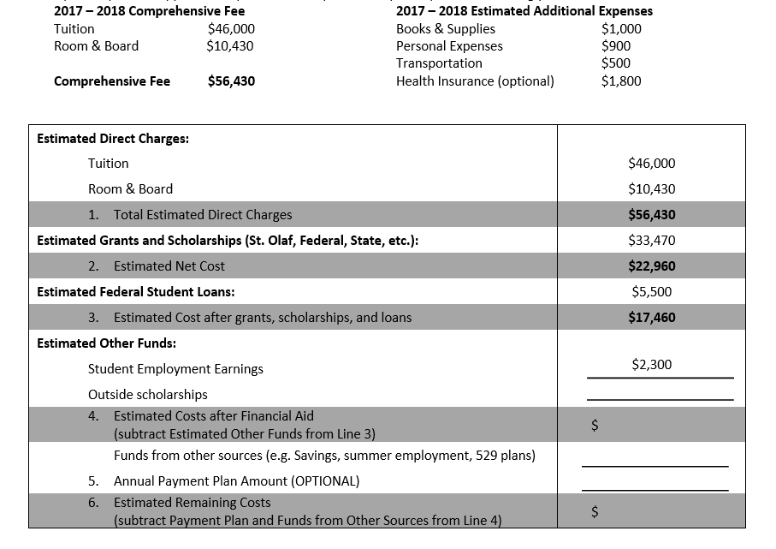
Figure out Net Price and Cost
Direct Charges
- Grants/Scholarships
= Net Price
Net Price – Loans = Cost after guaranteed aid
Net Price – Work Study – Federal Loans = Amount due out of pocket

Slide 46
Special Circumstances
When the numbers don’t tell the whole story or situation has changed (or is expected to change)
  Family situation
  Fluctuating/One-time income
  Change in employment
  Medical/dental expenses
  Marital status
Must be able to provide documentation
  Copies of bills, canceled checks, termination letters, etc.

Slide 47
Appeal the award if there is a valid reason
Possibly valid reasons:
  You have a unique family situation that isn’t evident from the FAFSA data.
  Your family’s financial situation has changed since you completed the financial aid application
  Probably not valid reasons:
  Another school gave me a better award.
  I heard/read I should “negotiate.”
  My parents are unwilling to provide their information/or unwilling to contribute.
  My parents got married on your campus.

Slide 48
Contact info
Steve Lindley
  Associate Director of Financial Aid
  lindley@stolaf.edu
  507-786-3521

