Slide 1
Affordability

Slide 2
Paying for College
Congrats! You are going to college!
Now it’s time to figure out the costs…

Slide 3
Talk with Your Parents
While it’s your experience, it affects the whole family…
Make sure everyone is on the same page.
Make sure you have some schools you know your family can afford.
Adjust your list based on this conversation.
You will save A LOT of stress in the spring by talking about this now.

Slide 4
College Can Be Expensive
While scholarships are nice…
Most financial aid dollars will come from the college you will attend.
Applying to scholarships can be more time consuming than applying to colleges.
So, craft a list with some affordable options too!

Slide 5
Tools to Help You
There are lots of ways to start making sure you have good options:
Parents and family
Counselors
Career and College Coordinator
Net-Price Calculators

Slide 6
Counselors and the CCC
Meet with your Counselor!
They know a lot
They want you to succeed
They want to make sure you pursue smart options
Go to the CCC
They know a lot too!
They can walk through financial aid forms
You can do an estimator

Slide 7
Net Price Calculators
All colleges must have a calculator that helps you get a good idea of what it costs to attend.
Typically found on Financial Aid websites

Slide 8
Net Price Calculators
Example 1
Family of 3
$70,000 total parent income
$2100 student income
See the results…

Slide 9
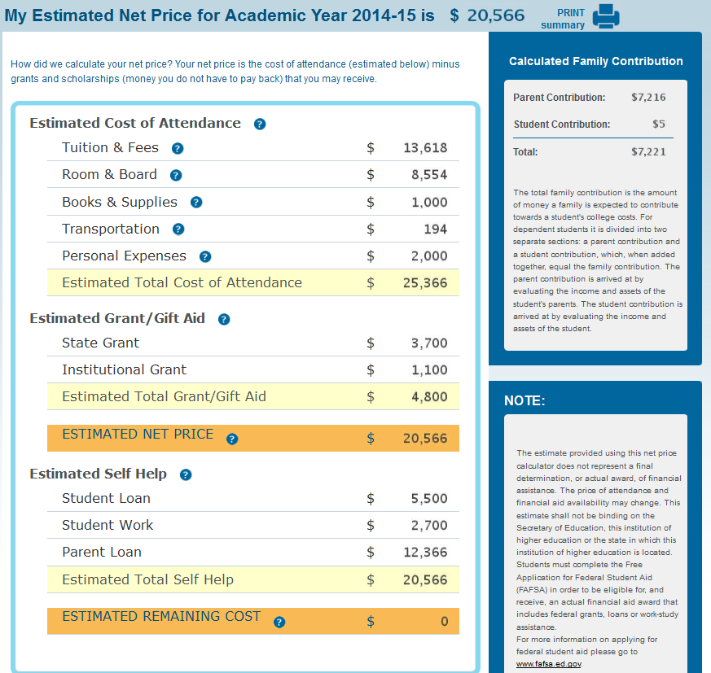
Money You
Don’t Pay Back
Money You
Pay Back

Slide 10
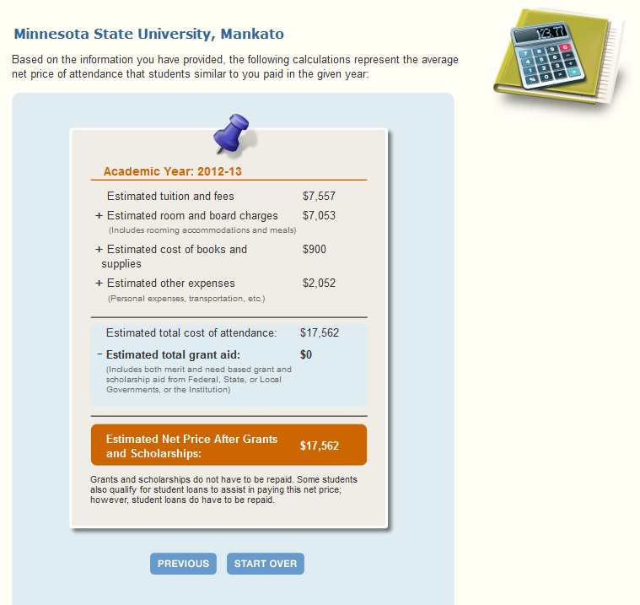
Money You
Don’t Pay Back
Money You
Pay Back

Slide 11
Net Price Calculators
Example 2
Family of 5
$32,000 total parent income
$5400 student income
See the results…

Slide 12
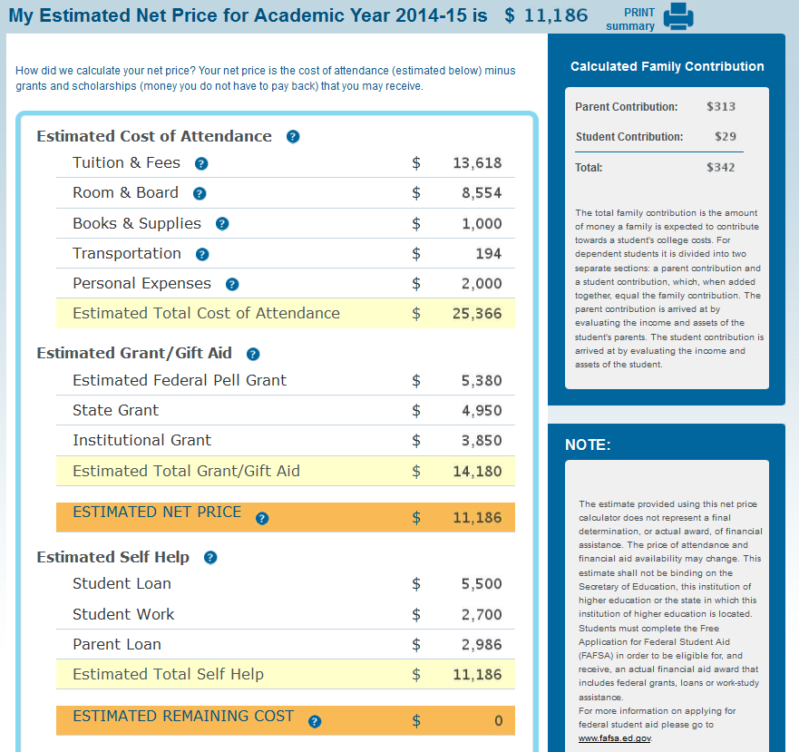
Money You
Don’t Pay Back
Money You
Pay Back

Slide 13
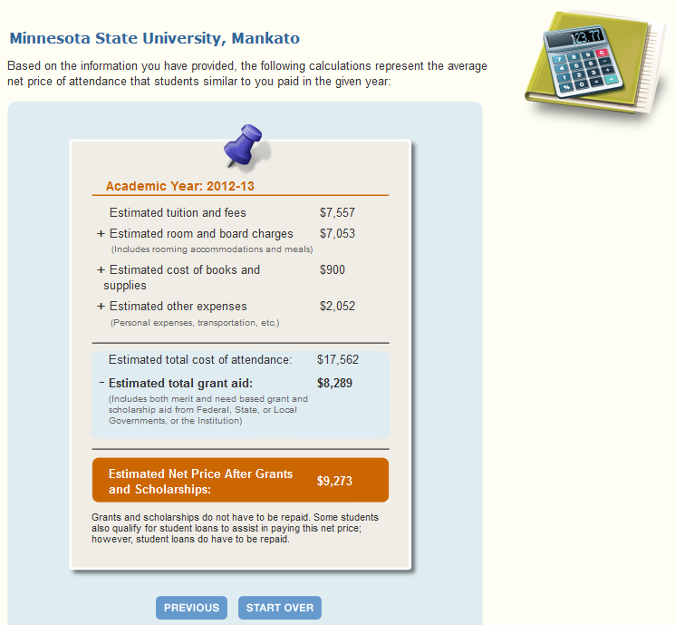
Money You
Don’t Pay Back
Money You
Pay Back

Slide 14
Be Mindful…
Make sure you know all the costs!
In-State | Description | Out-of-State
Direct Cost |  | Direct Cost
$10,626 | Tuition and Fees | $25,750
$12,716 | Room and Board | $12,716
$23,342 | Total Direct Cost | $38,466
Indirect Cost |  | Indirect Cost
$1,200 | Books | $1,200
$500 | Transportation | $2,500
$2,191 | Miscellaneous | $2,191
$70 | Loan Fees | $70
$3,961 | Total Indirect Cost | $5,961
$27,303 | TOTAL (Direct + Indirect) | $44,427

Slide 15
Some Affordable Options
There are options to make sure you can afford college.
Minnesota State Colleges and Universities (MNSCU)
Four-year Colleges (Winona, St. Cloud, Mankato, etc.)
Community Colleges
Power of You Program (MCTC and St. Paul College)
Reciprocity
Direct (ND, SD, WI, Manitoba)
MSEP (Midwest Student Exchange Program)

Slide 16
Questions?

