Slide 1
2015 Understanding Financial Aid

Slide 2
Where you are now:
Completed FAFSA
Free Application for Federal Student Aid
EFC
(Expected Family Contribution)
College 1
Fin Aid Office
College 2
Fin Aid Office
College 3
Fin Aid Office
We’ll give you:
$_ Grant
$_ Scholarship
$_ Loan
We’ll give you:
$_ Grant
$_ Scholarship
$_ Loan
We’ll give you:
$_ Grant
$_ Scholarship
$_ Loan

Slide 3
Important to Know!
No standard for financial aid award letters.
Costs may be higher than the Expected Family Contribution (EFC).
Packaging of non-need loans
“Gapping”
Not all costs may be included.
Direct Costs
Tuition and Fees
Room and Board
Indirect Costs
Travel
Computer
Health Insurance
Personal Expenses

Slide 4
Different Packages
Let’s Review A Few…

Slide 5
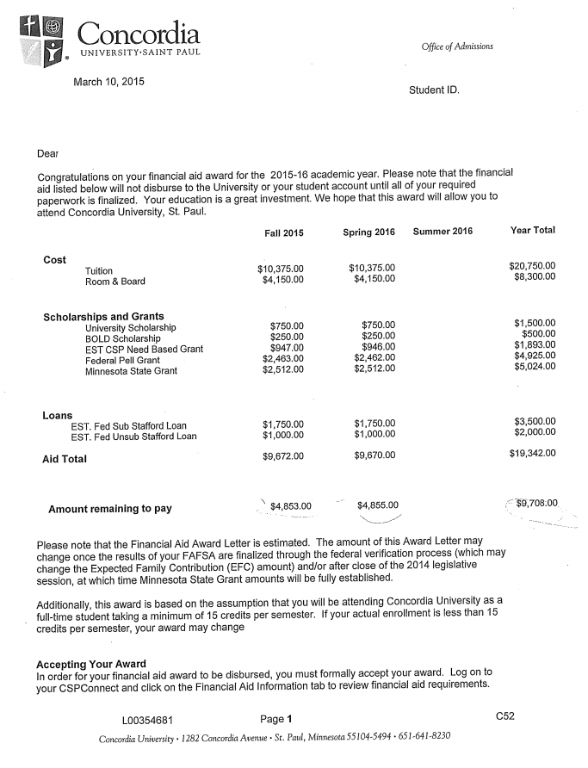
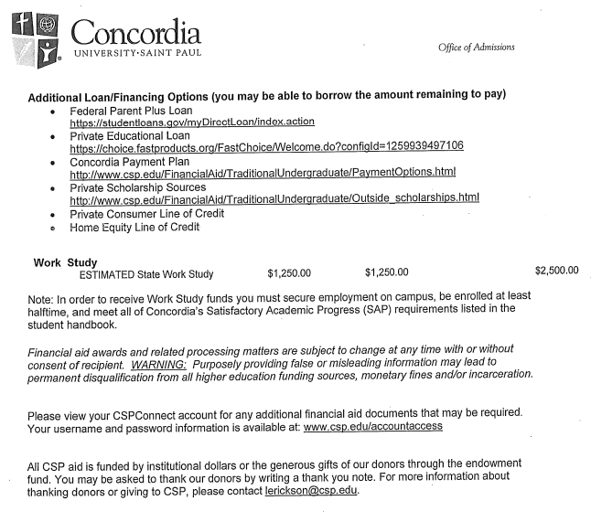

Slide 6
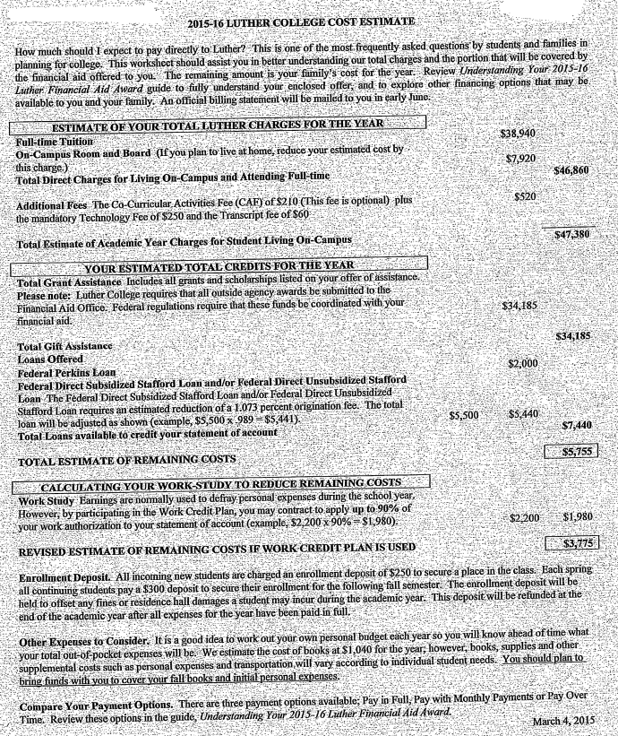
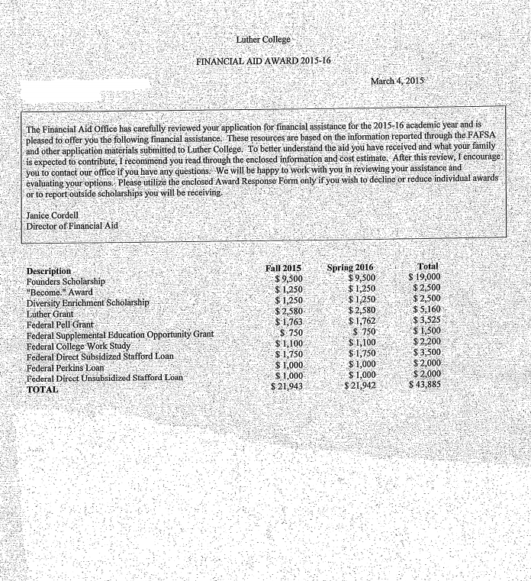

Slide 7
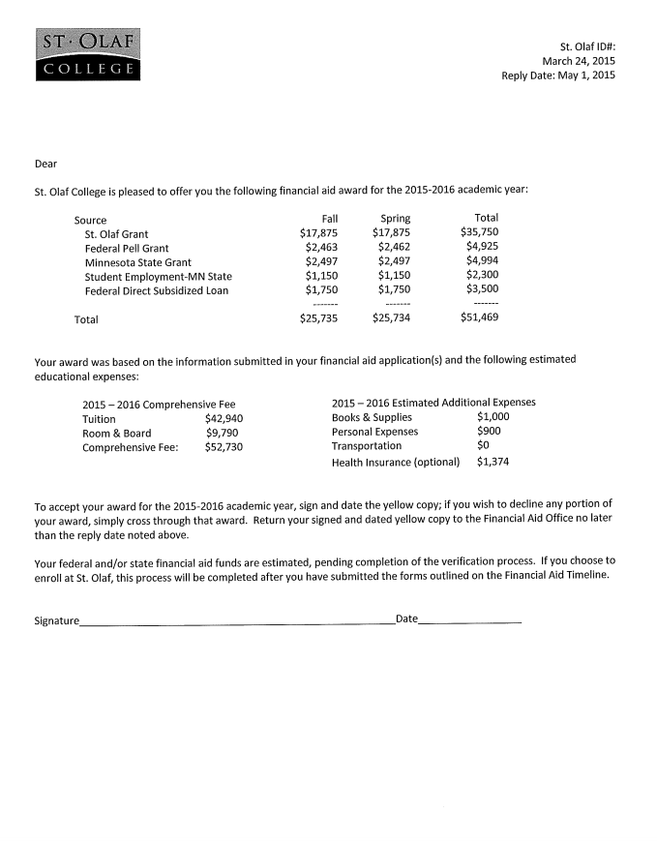

Slide 8
How to compare packages…

Slide 9
Using the College Shopping Sheet…
Today we are providing two options. They are VERY similar…
The Federal Shopping Sheet
Trimmed down and simple
Requires multiple to compare packages
Financial Aid Comparison Worksheet
Puts all your colleges on one sheet
Helps determine if you have unmet need.

Slide 10
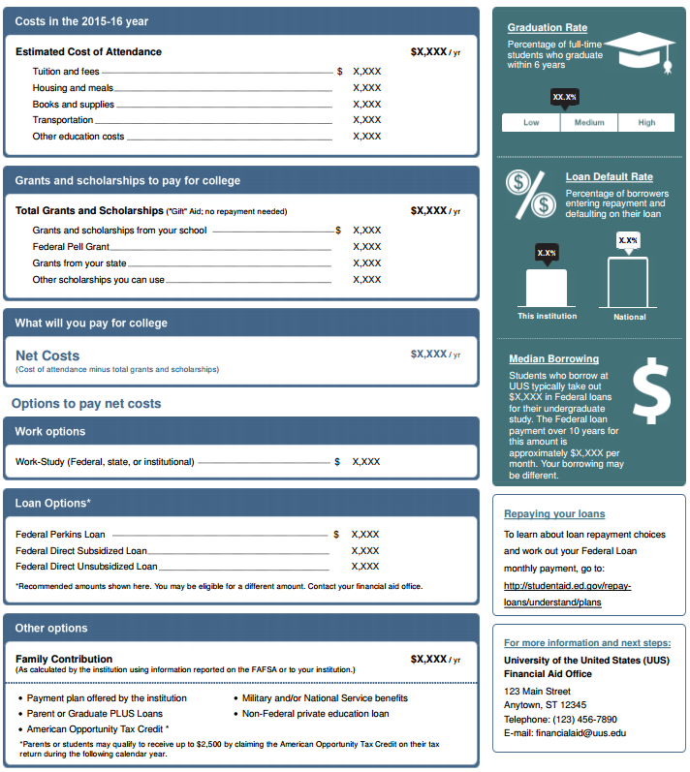

Slide 11
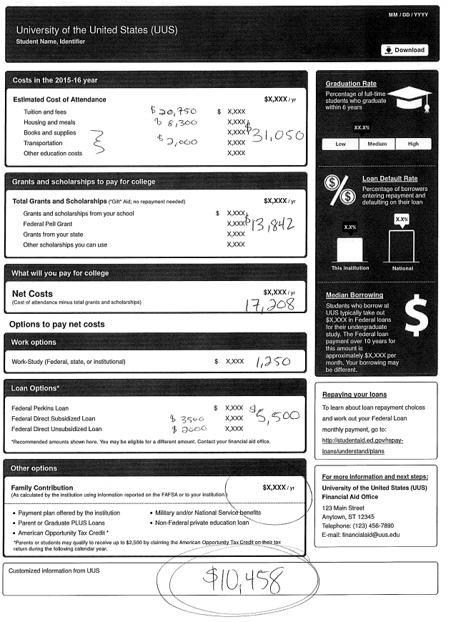

Slide 12
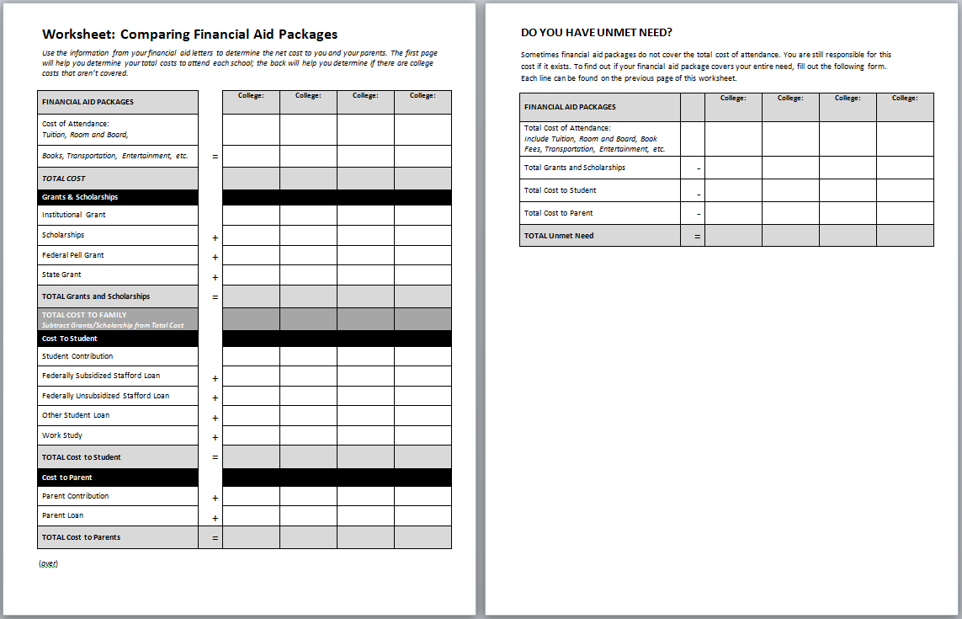
Financial Aid Comparison Sheet

Slide 13
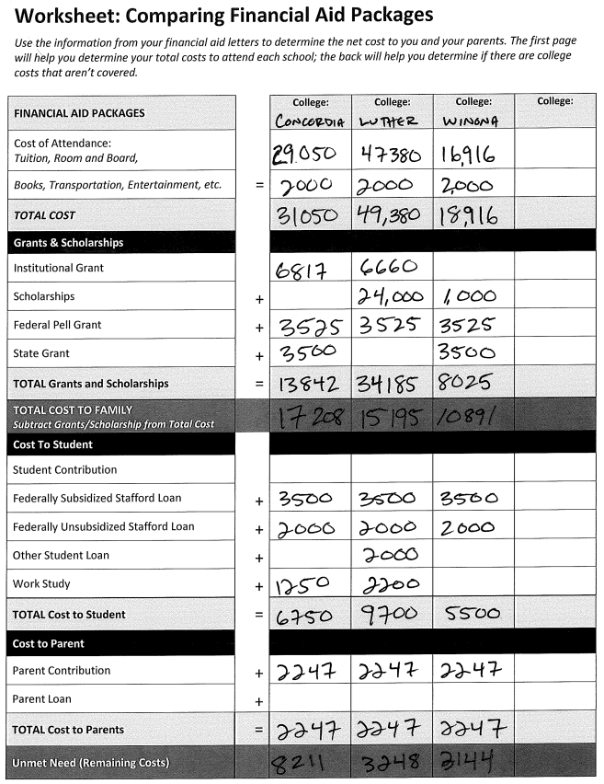
Unmet Need is the portion of your Total Cost not covered by financial aid or your Expected Family Contribution.
Your family will need to decide how to cover this. Options include further student loan, parent loan, or summer work.
This is your bottom line.

Slide 14
What Next?
Contact School You Choose to Enroll In and Accept Aid Package
Ask any questions to clarify their aid offers
Loans? Complete your Entrance Loan Counseling and sign your Master Promissory Note (MPN) for each loan you accept.
Remember, you don’t need to take the full amount…but you do have to pay it.
Private Scholarships may offset your need-based aid
Understanding Loan Repayments: https://studentaid.ed.gov/types/loans
Conventional wisdom on student loan borrowing: Only borrow what you expect to make in your first year out of school.
Become a “regular” at the Fin Aid Office
Seriously, these folks can help you save big $$$

