Slide 1

Class of 2019 College Launch

Slide 2

Take a Deep Breath

Slide 3

Agenda
Topics Covered:
Choosing a Path
Admissions 101
ACT Review
Developing Your List
Timeline
Topics in Fall (weekly meetings):
Applications
  Types, Deadlines
  Working with your counselor
Gathering Information
  Meeting Reps, Visits, Fairs
Financial Aid
Scholarships

Slide 4

Choosing a path
With rare exception, all will need some sort of post-secondary education (training) after high school graduation to meet their career or life goals.
    Should one know these goals by next year?
    Be prepared to change your mind many times.
    Ask older people about their career path, regrets, philosophy toward work.

Slide 5
A World of Possibilities
A. Traditional 4-Year College
  Societal expectation?
  Cost-benefit analysis would be wise
  Do you like school? Do you like to study?
B. Community College (transfer)
  Could be a less exciting but financially prudent choice
C. Technical College
  Some very high demand, less glamorous but well-paid careers
D. Art Schools, Conservatories
  Narrow focus, affordability, employability

Slide 6
A World of Possibilities (Continued)
E. Gap Year
  Structured volunteerism, travel, study
F. Apprenticeships
  Hands on job with concurrent paid-for schooling
G. Military
  Can provide educational benefits
  Many options. Consult with an impartial source!
H. Taking time off to work
  Once away from school, will you go back?
  Money that seems good at 19 may not seem so good at 26.

Slide 7
Occupational Outlook Handbook’s Sampling of Fastest Growing Jobs
Wind Service Technician, 49K, Tech Degree
Physical Therapy Assistant, 54K, Tech Degree
Nurse Practitioner, 95K, Bachelor’s and Masters
Physical Therapists, 83K, Bachelor’s and Master’s
Physical Therapy Assistant, 55K, Tech Degree
Operations Research Analyst, 77K, Bachelor’s
Financial Advisor, 81K, Bachelor’s
Interpreters, 44K, Bachelor’s
Optometrists, 101K, Bachelor’s and Master’s
https://www.bls.gov/ooh/fastest-growing.htm

Slide 8
ADMISSIONS 101
What are my options?
What do colleges want?
How do I get in?

Slide 9
The College Search Philosophy
“College is a match to be made, not a
prize to be won. Finding a good fit requires
time and thoughtfulness.”
It’s all about the fit.
Where you go matters less then what you do once you are there.

Slide 10
Admissions 101
Most colleges hold the following in high regard:
  Academic Record (GPA & Rigor), ACT, “Hooks”
    Schools look to build a diverse and talented class that fits their needs.
      Hook- Specific attribute (Gender, Ethnicity, Geography, Unique talent, Legacy factor)
Most highly selective will look at the following secondary factors:
  Essays, LOR’s, Activities, Interviews, Level of interest

Slide 11
Academic Record and Test Scores
Un-weighted GPA and Un-ranked class
  Admissions office re-calculation
  HS Counselor evaluation of rigor
ACT/SAT
  The one objective measure in an application
  Can take multiple times- June (@ JP), Sept, Oct, Dec
  Fee Waivers
  On-line registration help in CCC
  Test preparation
  SAT II Subject tests

Slide 12
Developing Your List
But there are so many! How do I narrow it down?

Slide 13



Initial College Search
Start broad, then funnel down
Not eliminating options based on cost
  Be aware, but consider all options
  FAFSA estimators, Net Price Calculators
No “right/wrong,” just different priorities
  Rank priorities
  Remember that parents and students
  likely have different priorities…
Notes:
Look at profile of class from previous year
Don’t be afraid to apply to a lesser known school---merit aid?
Make sure the target school is not a really a reach school.
Kevin can tell story about his college search, the Princeton Review Guide, and the colored tabs.

Slide 14
Developing Your List
Determine your priorities—use checklist, use what you know!
  2 year vs. 4 year
  Proximity
  Cost
  Size
  Majors
  Academic Profile
  Location
  Public/private
Unsure on what you want?
  Visit different types of institutions!

Slide 15
Developing Your List
Other things to look for…
  Religious affiliation
  Social life
    Extra-curriculars
    Character of campus
    Fraternities and sororities
    Residential vs. commuter
  Student Support
  Graduation Rate
Even more to look for…
  Diversity
  Research/Internship Opportunities/Unique Programs
  Study Abroad
  Co-ed or not?
  Scholarship Opportunities
    Merit-based
    Need-based

Slide 16
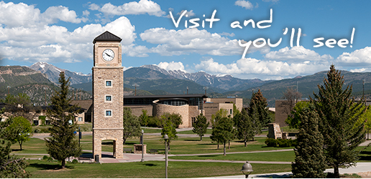
Developing Your List
Visiting Campuses is Powerful!
Set up your visit through a school’s admissions office.
Either call their visit line or book online!

Slide 17
Visiting the Campus
WHEN?
WHAT TO DO?
Summer- OK
Spring Break 2019: Better
During the school year: Best
Get past the pretty pictures!
See it in person!
Visit Days vs. Individual
Classes
Tours
Talk with Students
Eat on campus
Meet with Coaches
Take a lesson
Overnights
See the local area
ASK QUESITONS!
WHY?

Slide 18
Developing Your List
Build a balanced list…
We suggest you have 5-7 schools that include:
  Reach
      Less than 30% chance of admission
  Target
      30%- 60% chance of admission/affordability
  Likely
      60%-90% chance of admission/affordability
Are you a good fit? (Educational, personal, social, financial)
Should have at least 1 Target or Likely school in Minnesota

Slide 19
College Application Timeline
What you should be doing. When you should be doing it.

Slide 20

Spring/Summer
  Start searching
    Use on-line tools including Naviance
    Build a tentative list
  Re-take the ACT?
  Some schools require essays and LOR’s
    Not U of M nor MNSCU
  If REQUIRED to use Common App, look at essays
  Consider teachers you may ask for LOR’s in the fall
  Check out Net Price Calculators on college websites
  Register with NCAA Clearinghouse if applicable
  First glance at scholarships
Notes:
CHECK DIVISION 2?

Slide 21
College Search
There are multiple options for you!
  Naviance Supermatch
    Useful tool for comparing students directly with past Washburn High School students. The advantage to this is you can see how fellow Millers fared in their admissions decisions.
  BigFuture.Collegeboard.org/college-search
    Similar to Supermatch, but uses national numbers and information. PLUS→ “See similar colleges”
  Collegeresults.org
    If you have a pretty clear idea of what you want already, you can find very similar schools using this website.
  College Planning Resources

Slide 22
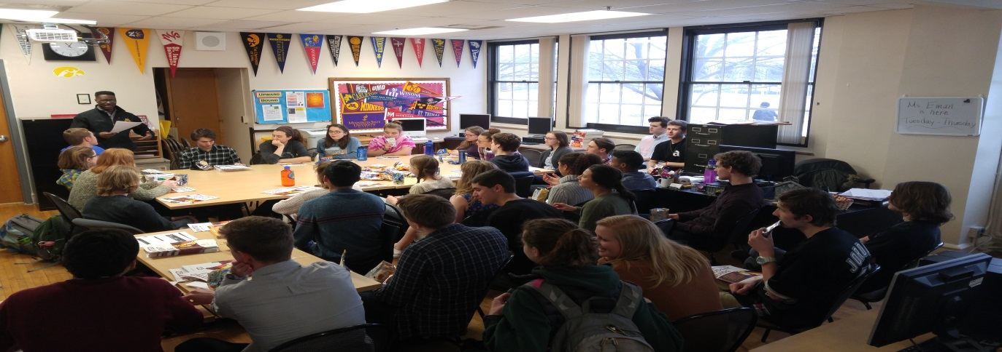
Rep Visits
Washburn invites several colleges, career and military representatives to visit students.
All visits take place in the CCC, room #107
Students sign up for visits ahead of time in Naviance
You will receive a yellow pass from the CCC the day of your visit to your 1st period class
You must get your pass signed by the teacher’s class you are missing before the visit starts. PLEASE NOTE-it is up to the teacher whether you are able to miss class.

Slide 23
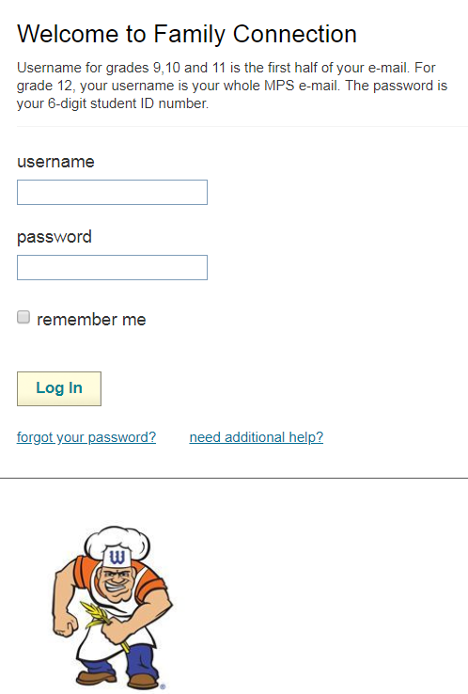
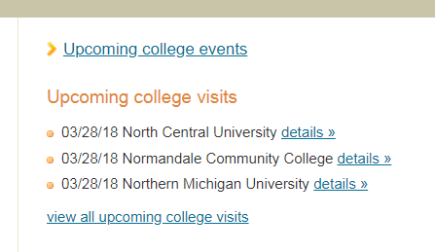
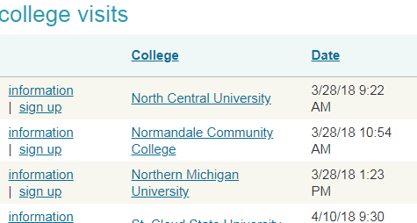
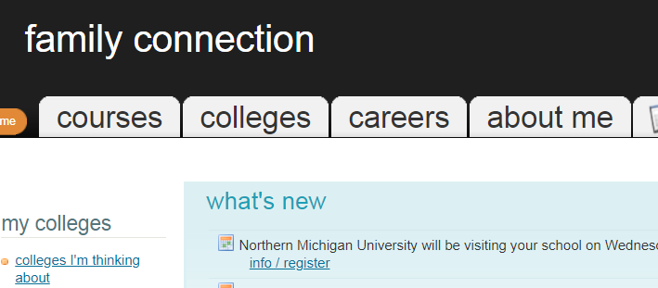
Signing Up for Rep Visits
Signing Up for Rep Visits
  Log into your Naviance account
  Click Colleges, upcoming visits
  Click on college that you'd like to visit
  Select sign up

Slide 24
September-November
Finalize your list of schools
Retake the ACT?
Need the SAT II?
Meet with College Reps in CCC
Go to college fairs
Visit colleges over MEA
Beware of application deadlines
  Most EA deadlines are between Nov1 and Dec 1

Slide 25
Winter-Spring 2019
December-January
  Finish regular decision applications
  Apply for financial aid
February-March:
  Receive accept/deny notices from colleges
  Apply for private scholarships
Spring Break 2019:
  Make final visits to colleges if needed
May 1, 2019:
  Final decision

Slide 26
ACT Interpretation

