Slide 1
Multiple Intelligences and Career Research

Slide 2
My Life Plan
Agenda/ What are we doing today?
Introduction to Multiple Intelligences (M.I.)
M.I. Assessment on Naviance, a self-discovery, career and college exploration and planning tool.
Researching a career in depth

Slide 3
Multiple Intelligences
Thinking about Intelligence differently…
Howard Gardner, psychologist,
broaden the scope of
human potential beyond the
confines of the I.Q. score.
“An intelligence is the ability
to solve problems, or to
create products, that are
valued within one or more cultural settings.”
(Gardner, 2006)

Slide 4
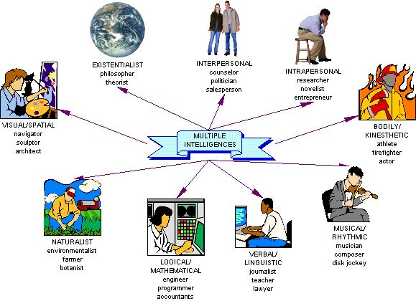

Slide 5
Key Aspects of MI Theory
Each person possesses all intelligences.
No two individuals have exactly the same intellectual profile.
Most people can develop each intelligence to an adequate level of competency.
Intelligences usually work together in complex ways.
There are many ways to be intelligent within each category.
(Gardner, 2006)

Slide 6
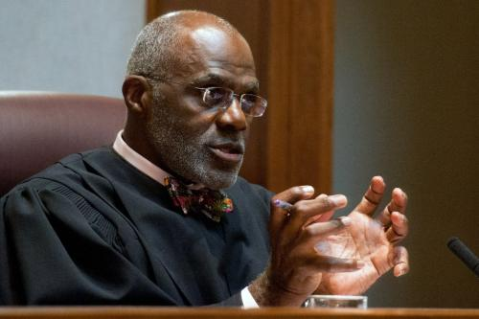
Verbal-Linguistic Intelligence
“Word Smart”
Well-developed verbal skills and sensitivity to the sounds, meanings and rhythms of words.
Books are very important to me.
I enjoy entertaining myself or others with tongue twisters, rhymes, or puns.
I enjoy listening to the spoken word.
Examples: journalists, teachers, lawyers

Slide 7
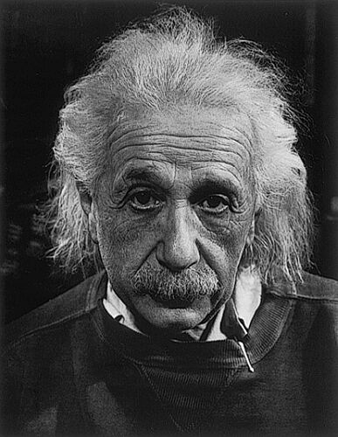
Logical-Mathematical Intelligence
“Logic Smart”
The ability to think conceptually and abstractly, and capacity to discern logical or numerical patterns.
I can easily compute numbers in my head.
I enjoy playing games or solving brainteasers
that require logical thinking.
I feel more comfortable when something has been measured, categorized, analyzed or quantified in some way.
Examples: engineers, programmers, accountants

Slide 8
Visual-Spatial Intelligence
“Picture Smart”
The capacity to think in images and pictures,
to visualize accurately and abstractly.
I enjoy doing jigsaw puzzles, mazes, or other visual puzzles.
I like to draw or doodle.
I prefer looking at reading material that is illustrated.
Examples: navigator, sculptor, architect

Slide 9
Bodily-Kinesthetic Intelligence
“Body Smart”
The ability to control one's body movements and to handle objects skillfully.
I engage in at least one sport or physical activity on a regular basis.
I move, twitch, tap or fidget while seated for a long time in one spot.
I am skilled in a craft with my hands or I am told I have good fine-motor coordination.
Examples: athletes, actors, firefighters

Slide 10
Musical Intelligence
“Music Smart”
The ability to produce and appreciate
rhythm, pitch and timber.
I can tell when a musical note is off-key.
I sometimes catch myself with a TV jingle or other tune running through my mind.
I often make tapping sounds or sing little melodies while working, studying, or learning something new.
Examples: disc jockey, composer, musician

Slide 11
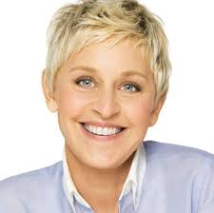
Interpersonal Intelligence
“People Smart”
The capacity to detect and respond appropriately to the moods, motivations and desires of others.
I enjoys socializing with peers.
I am street smart.
Others seek me out for my company.
Examples: counselors, politicians, salespeople

Slide 12
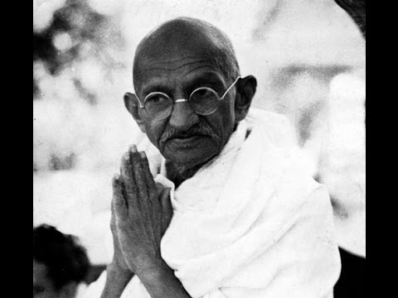
Intrapersonal Intelligence
“Self Smart”
The capacity to be self-aware and in tune with inner feelings, values, beliefs and thinking processes.
I have a strong sense of independence.
I do well when left alone to play or study.
I can accurately express how I am feeling.
Examples: researchers, novelists, entrepreneurs

Slide 13
Naturalist Intelligence
“Nature Smart”
The ability to recognize and categorize plants, animals and other objects in nature.
I talk about favorite pets or preferred spots in nature.
I enjoy field trips in nature, to the zoo or a natural history museum.
I get excited when learning about ecology, nature, plants or animals.
Examples: botanists, environmentalists, farmers

Slide 14
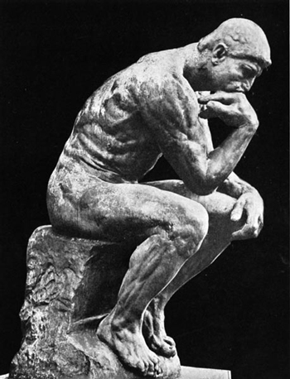
Existential Intelligence
The sensitivity and capacity to tackle
deep questions about human existence.
I enjoy thinking about how the world works.
I ask questions that go beyond our normal sensory experience.
I make connections between broad concepts and minute details.
Examples: philosophers, theorists

Slide 15
MLP 9.3 Multiple Intelligences
MI Inventory on Naviance- 72 questions (will take 15 minutes to complete)
Open up Naviance, Use Google Chrome!
Go to www.washburn.mpls.k12.mn.us
Hover over “Students”
Click “Naviance”
Log-In
Don’t know your username or password?
Click on…
“My Planner” then…
“Tasks Assigned to Me” then…
9.3 MI Advantage
kesa1051
Student ID Number!

Slide 16
MLP 9.4 Career Research
Once finished, click on “see related careers”

Slide 17
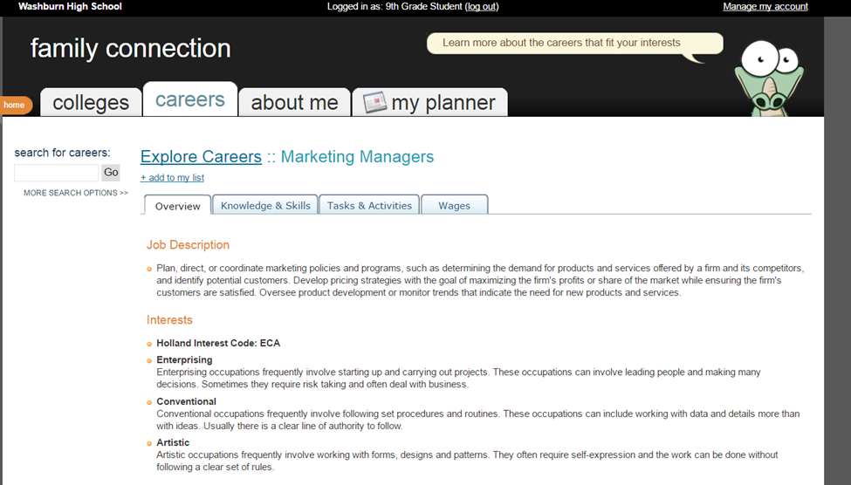
MLP 9.4 Career Research
Choose ONE career from your related careers list
Click on “+add to my list” and fill out MLP 9.4 Career Research worksheet

